Slide 1
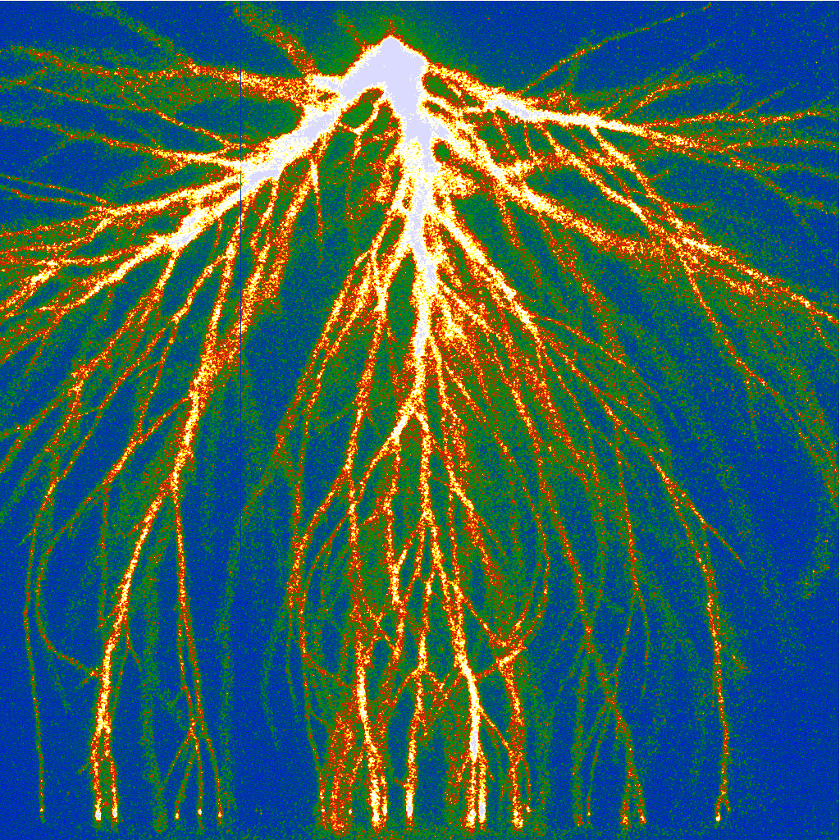
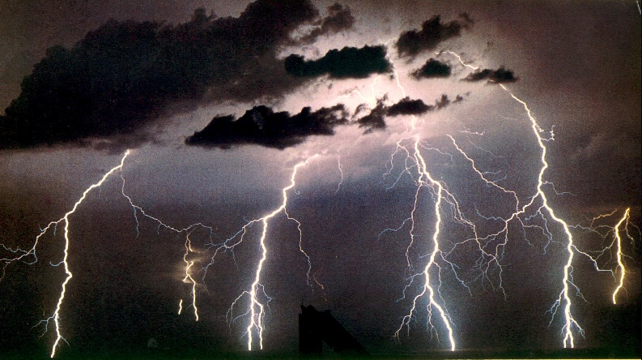
Modeling discharge trees
Ute Ebert, CWI and TU/e
TexPoint fonts used in EMF.
Read the TexPoint manual before you delete this box.: AAAAA

Slide 2
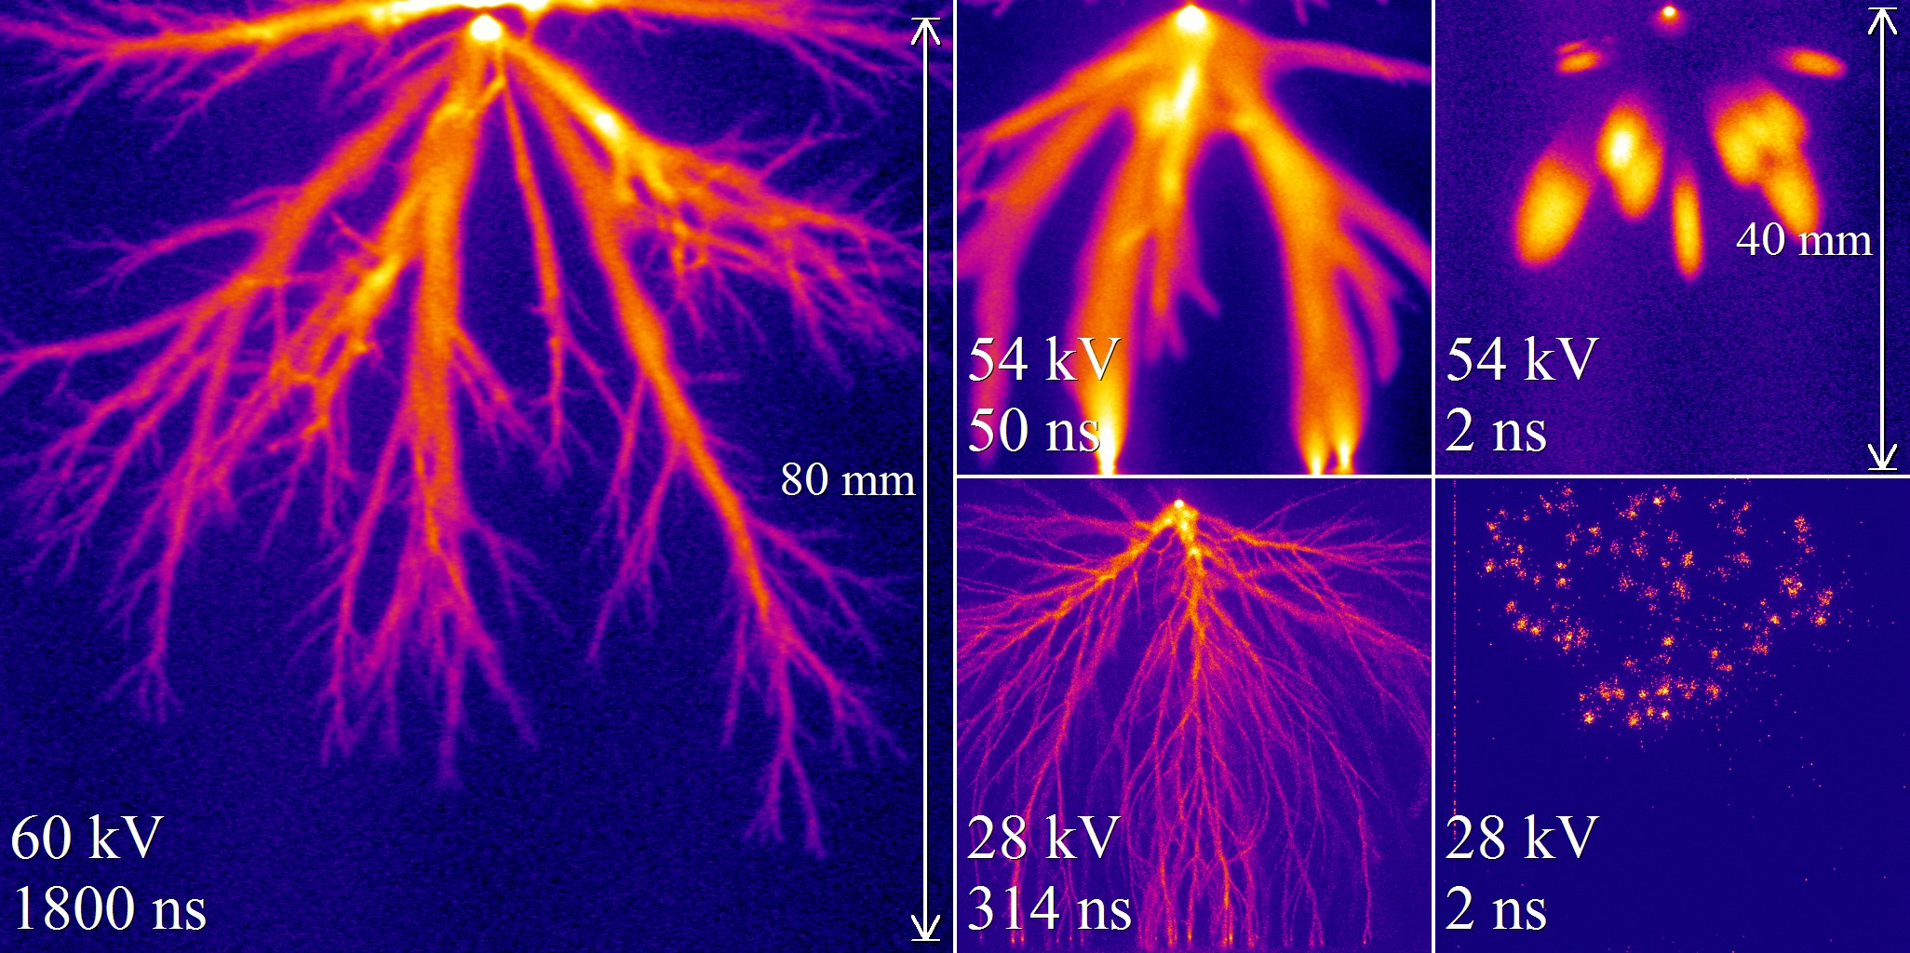
Streamers in STP air [Briels et al., J Phys D 2008], [Nijdam …]

Slide 3
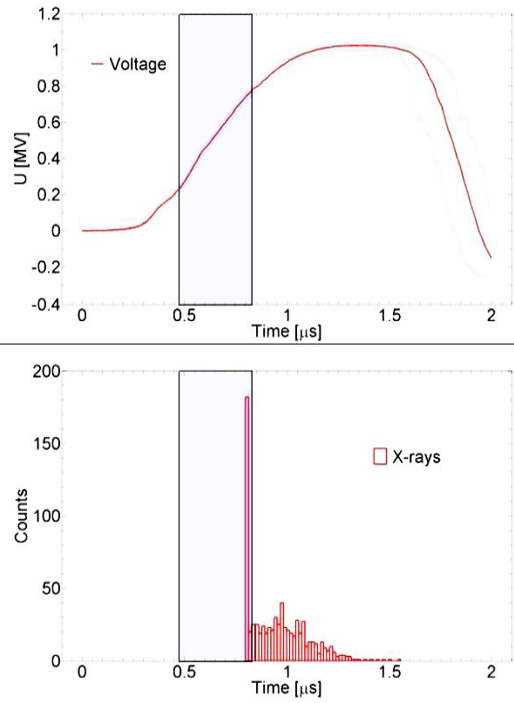
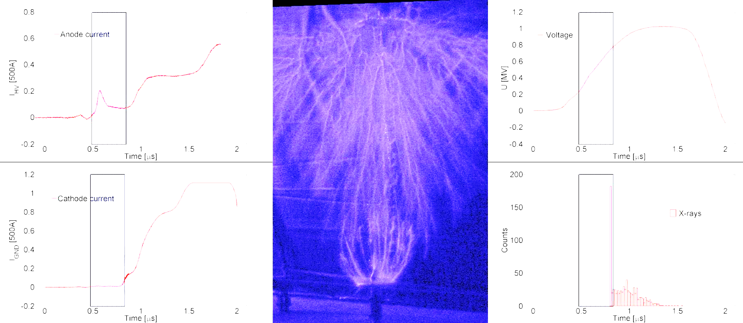
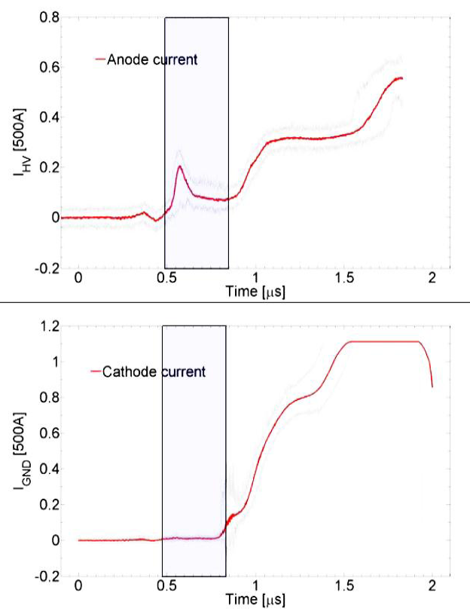
Hard X-rays (>200 keV) from positive “sparks”
1 m
1 MV over 1 m
X-ray source:
Negative streamers!
Typical energies: ~200 keV
[Kochkin, Nguyen, van Deursen, Ebert, J Phys D 2012]

Slide 4

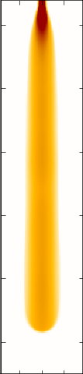
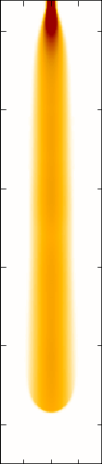

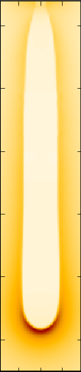


A streamer: field focussing
Complete system: Zoom:
n_{e}, equi-φ n_{e} n₊ n₊-n_{e} |E| + equi-φ

Slide 5
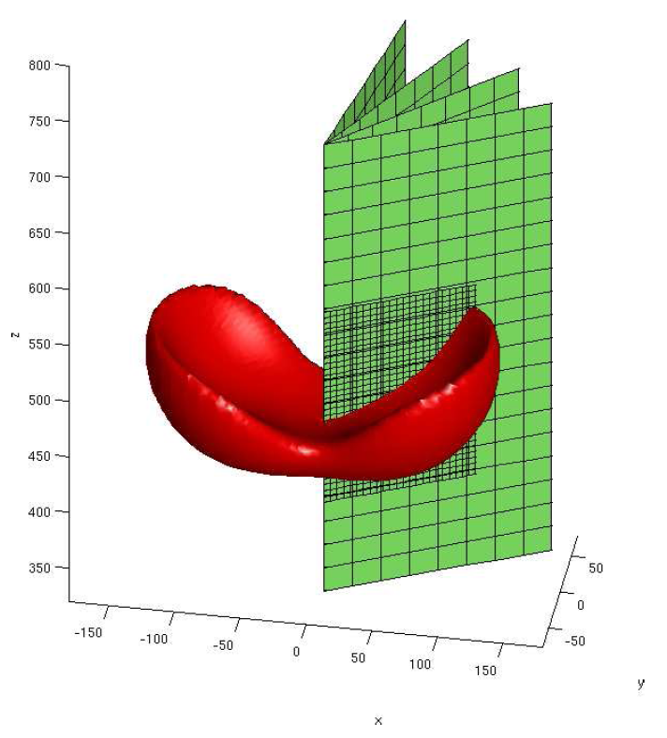
2 interacting streamers in 3D (in 2008):
Surfaces of equal electron density
Electrostatic repulsion versus attraction through photoionization
2.5D adaptive mesh refinement
Code now on the web
[Luque et al., Phys Rev Lett 08]

Slide 6
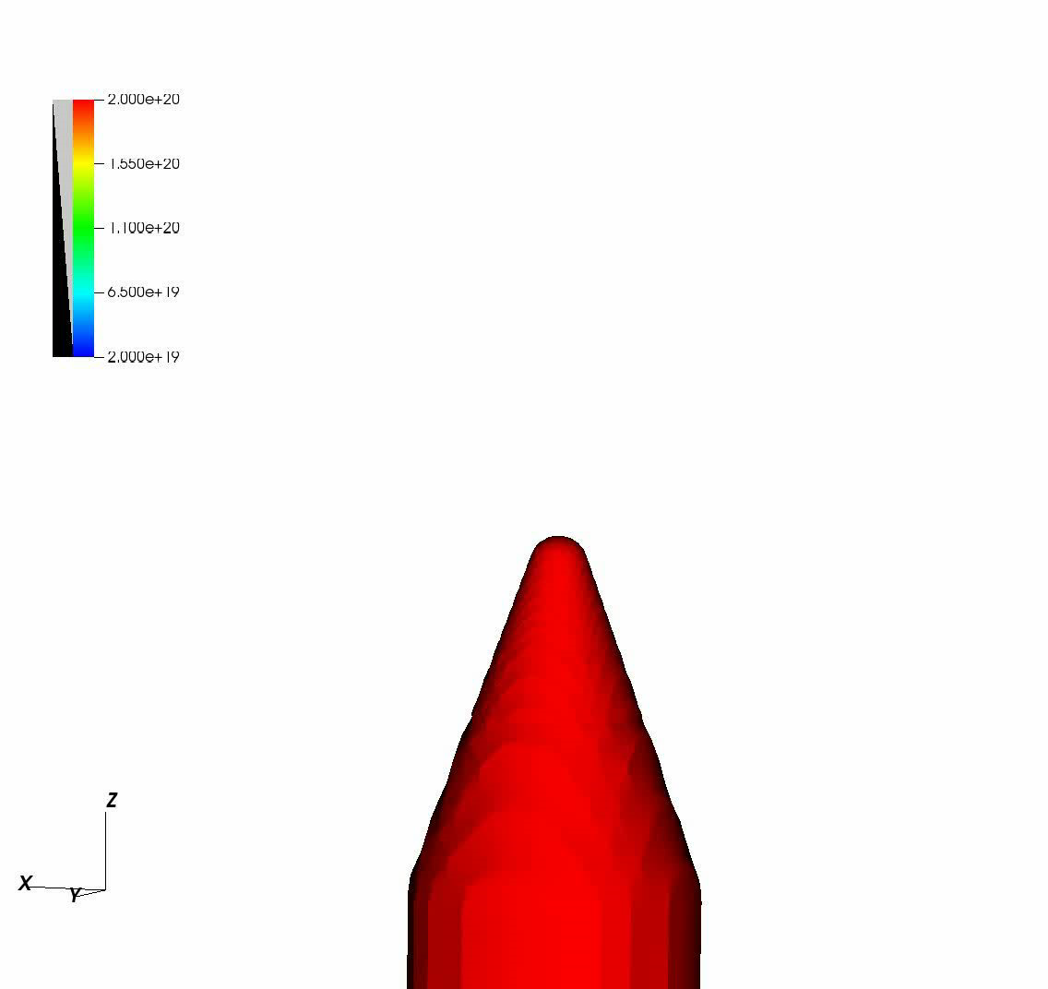
8 kV
[Jannis Teunissen]

Slide 7
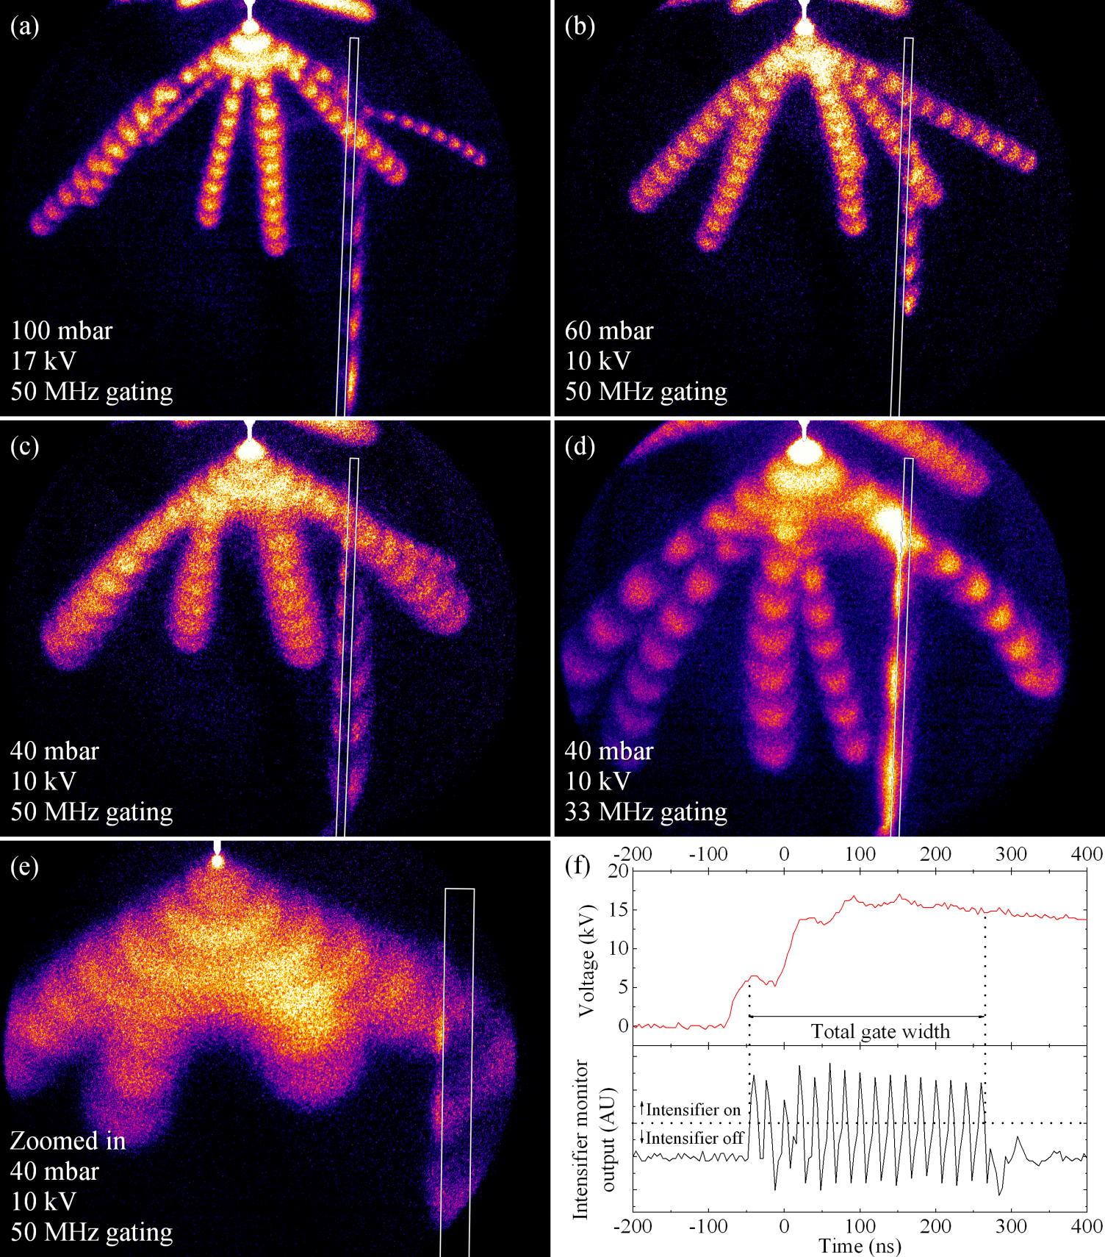
[Dirk Trienekens]

Slide 8
12 kV

Slide 9
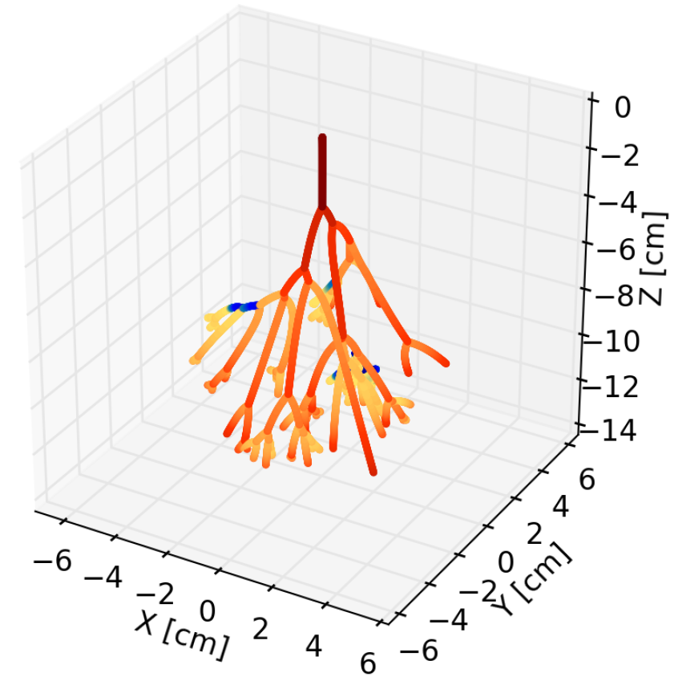
Simplest streamer tree model with consistent charge transport
All streamers have the same diameter and conductivity.
Tip velocity ~ local field.
[Luque, Ebert, submitted, arxiv].

Slide 10
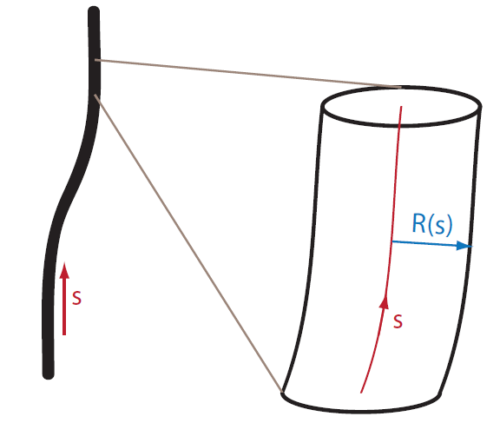
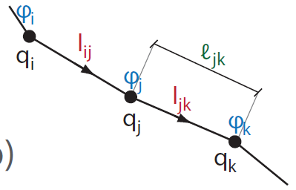
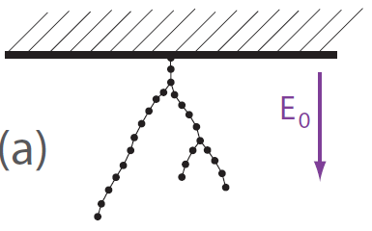

Slide 11
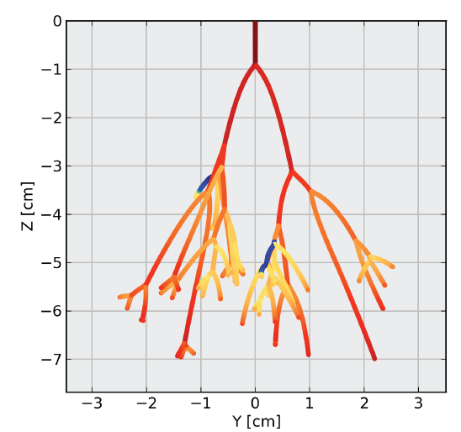
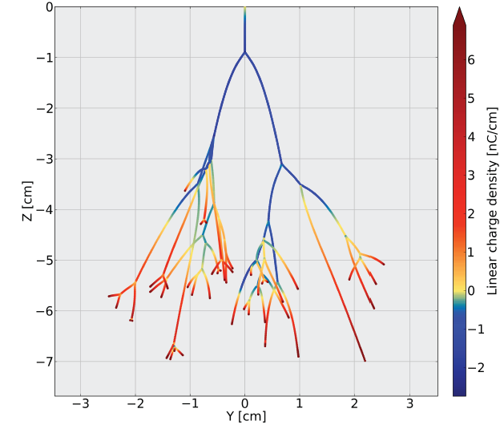
Electric field
with field inversion
Positive and
negative line charge
[Luque, Ebert, submitted]

Slide 12
Diameter of positive and negative streamers
Air, 1 bar, 40 mm gap
~ factor 10
~ factor 2
[Briels et al., J Phys D 08]

Slide 13
Characterize streamer head by E_{max} and R
Analytical approximations:
n_{interior} ≈ ε₀ /e ∫₀ ^{Emax} α(x) dx
v = v(R, E_{max})
j_{interior} = 2v ε₀ E_{max}/R
Equation for d_{t}R at tip?
Branching?
3D particle/hybrid simulations of streamer head?

Slide 14
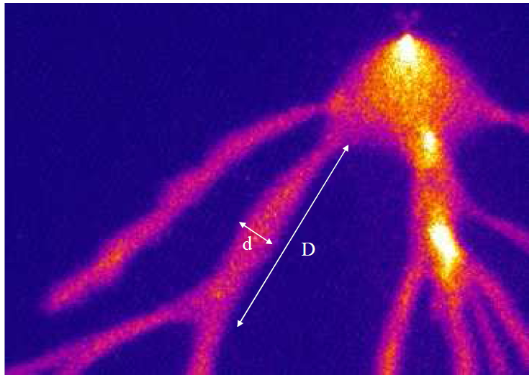
Branching of positive streamers in STP air:
Experiments: D/d = 12 - 15 [Briels JPD 2008, Nijdam JPD 2010]
Model intrinsic fluctuations as electrons are discrete:
D/d = 8 in STP air [Luque, Ebert, Phys Rev E 2011]

Slide 15
Electric field
with field inversion
Positive and
negative line charge
[Luque, Ebert, submitted]
Include longer time scales: Chemistry, heating and transition to leader [Markosyan et al.]

