Slide 1



Investigation of positive streamers by double pulse experiments
S. Nijdam¹, E. Takahashi², A. Markosyan³ and U. Ebert^{1,3}
Department of Applied Physics, Eindhoven University of Technology, The Netherlands.
National Institute of Advanced Industrial Science and Technology (AIST), Tsukuba, Japan.
CWI, Amsterdam, The Netherlands.

Slide 2
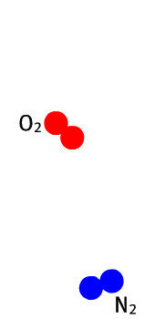
Positive streamer propagation
Electron source:
  Photo-ionization
    UV-photon (98-102.5 nm) from N₂ in streamer head
    Ionization of O₂ in bulk gas
  Background ionization
    From previous discharges
    Natural/radioactive
Photo-ionization

Slide 3
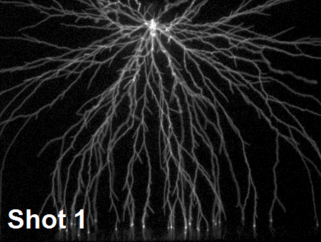
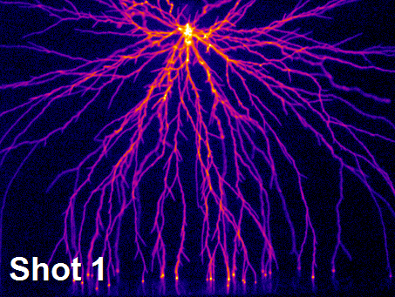
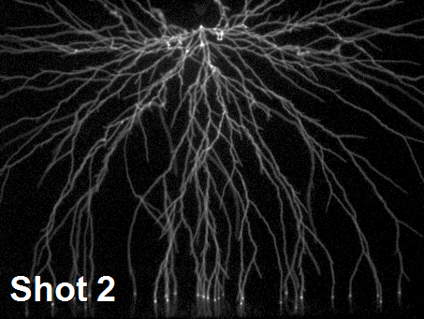
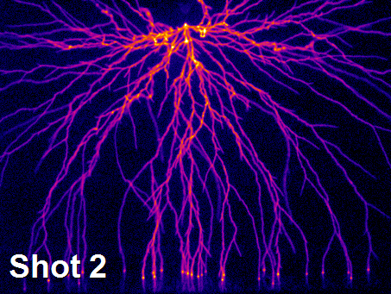
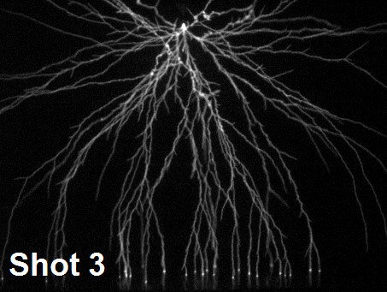
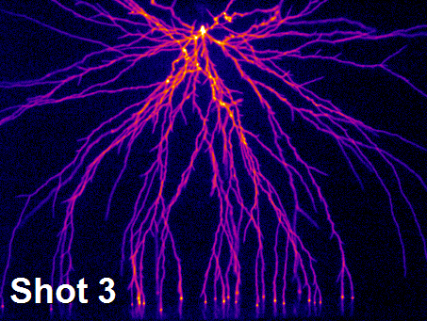
Do streamers follow the same path?
Streamers with 1 Hz repetition rate
200 mbar pure N₂ , 160 mm point-plane, 15.4 kV pulse
Nijdam et al. J. Phys. D: Appl. Phys. 44 (2011) 455201

Slide 4
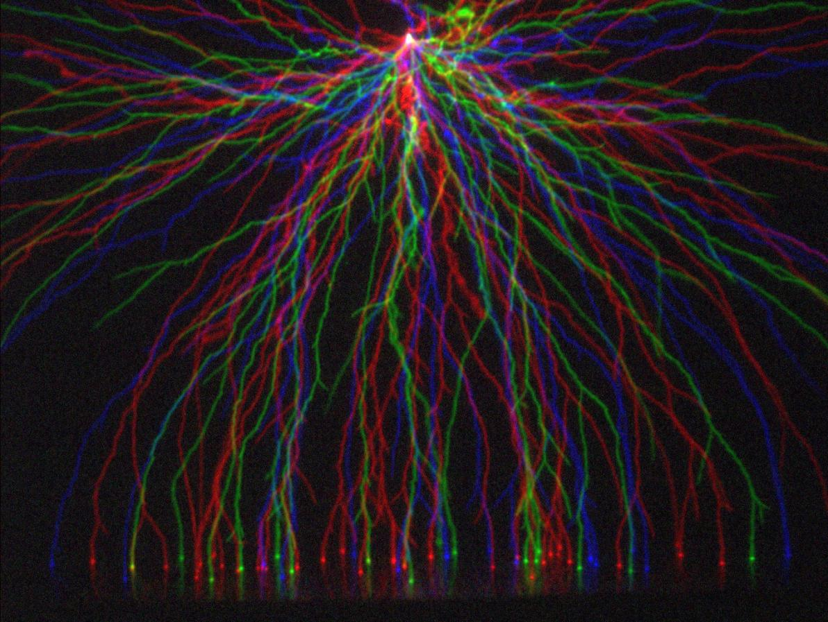
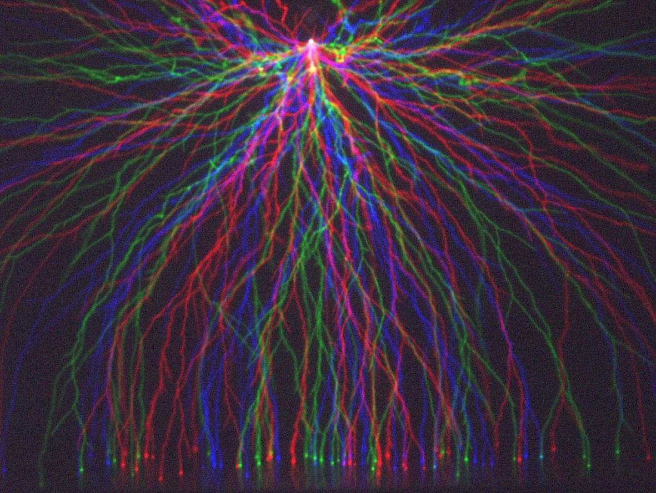
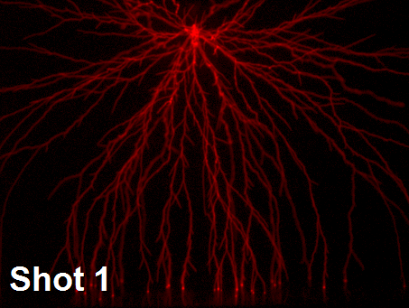
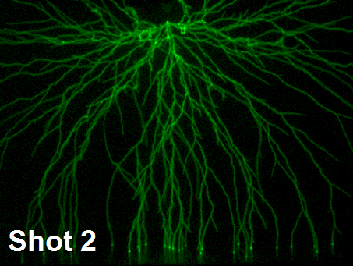

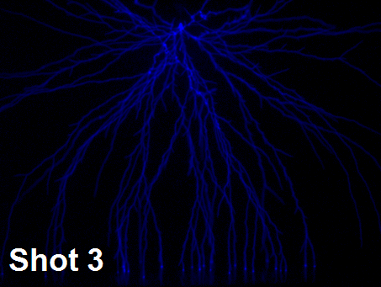
Do streamers follow the same path?
No
Same for 10 Hz
200 mbar pure N₂ , 160 mm point-plane, 15.4 kV pulse
Nijdam et al. J. Phys. D: Appl. Phys. 44 (2011) 455201

Slide 5
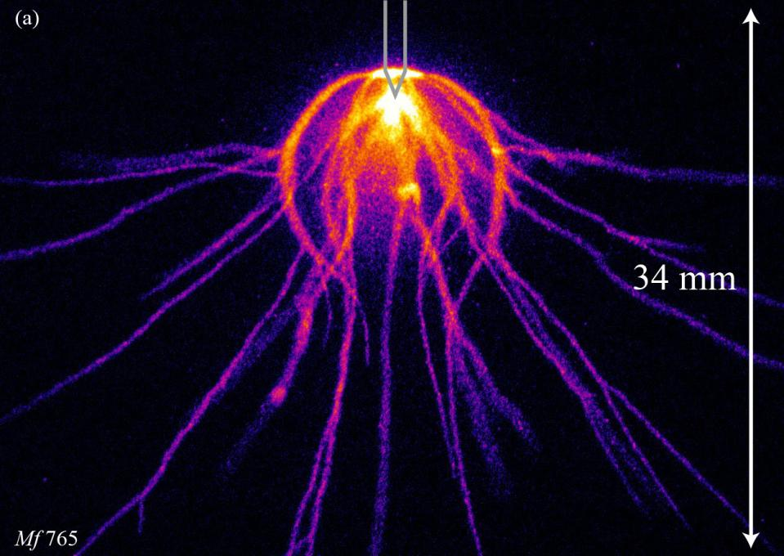
The ‘onion-shaped’ streamer discharge
600-1000 mbar artificial air
160 mm point-plane
Negative pulse from Blumlein pulser
Nijdam et al. IEEE T. Plasma. Sci. 39 (2011) 2216

Slide 6
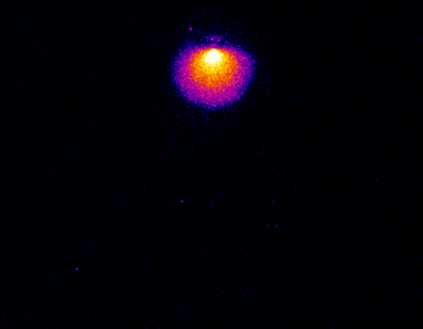
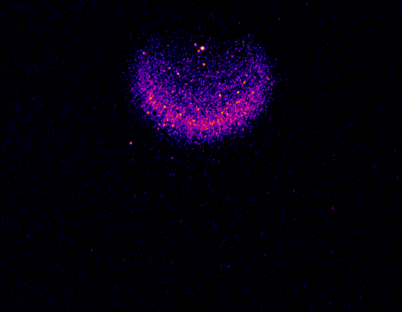
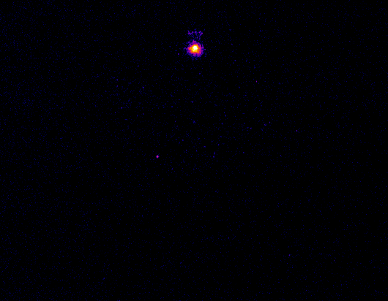
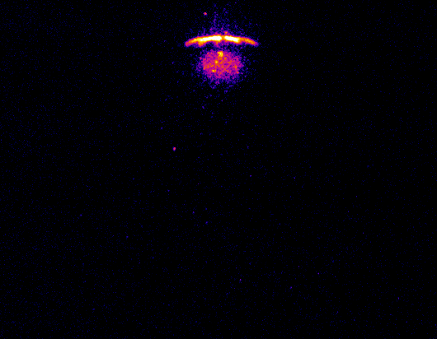
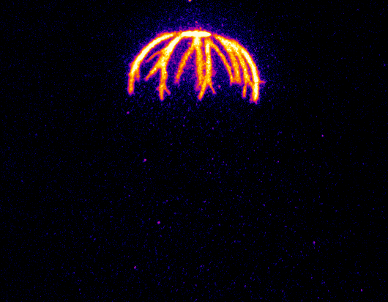
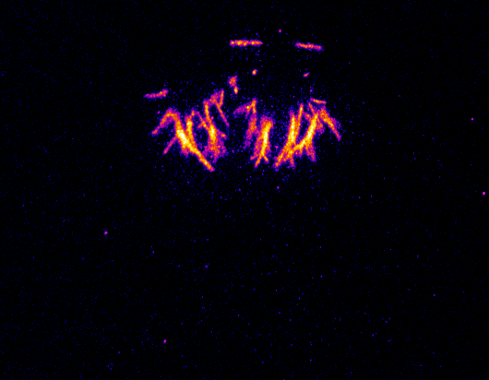
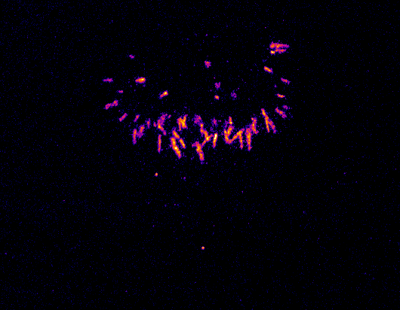
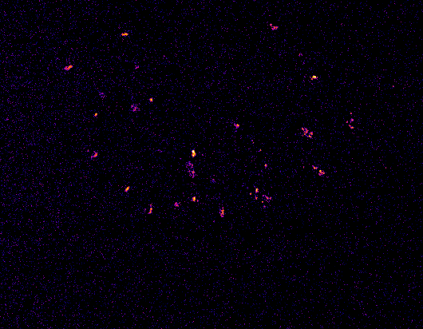
Time resolved
Negative polarity: inception cloud
Cloud extinguishes
Positive polarity: cloud from tip, streamers from edge
Cloud extinguishes, streamers travel along remains
Streamers move outwards

Slide 7
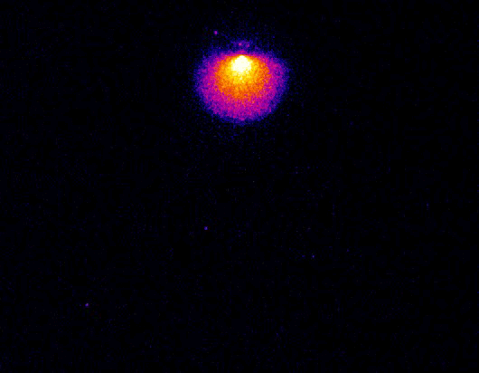
Discussion
Voltage pulse shape causes positive streamers after negative polarity discharge
Positive streamers go around cloud
  Attracted by edge?
  Repulsed by interior?

Slide 8
Double pulse Experiments
Effects of repetition frequency over large range (25 Hz – 5 MHz)

Slide 9
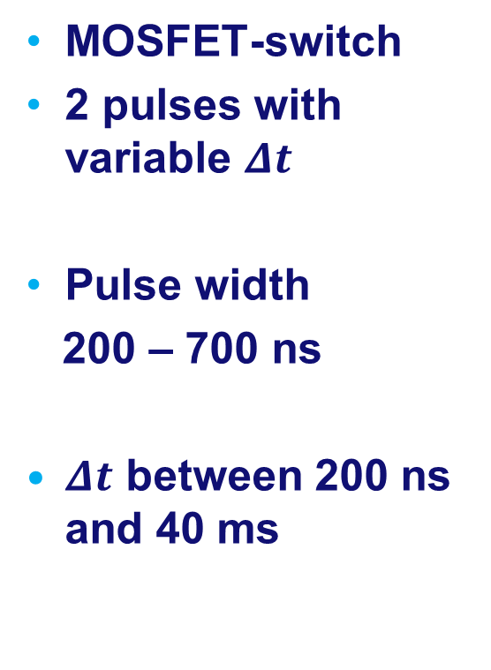
Double voltage pulse
MOSFET-switch
2 pulses with variable $Δt$
Pulse width
200 – 700 ns
$Δt$ between 200 ns and 40 ms

Slide 10
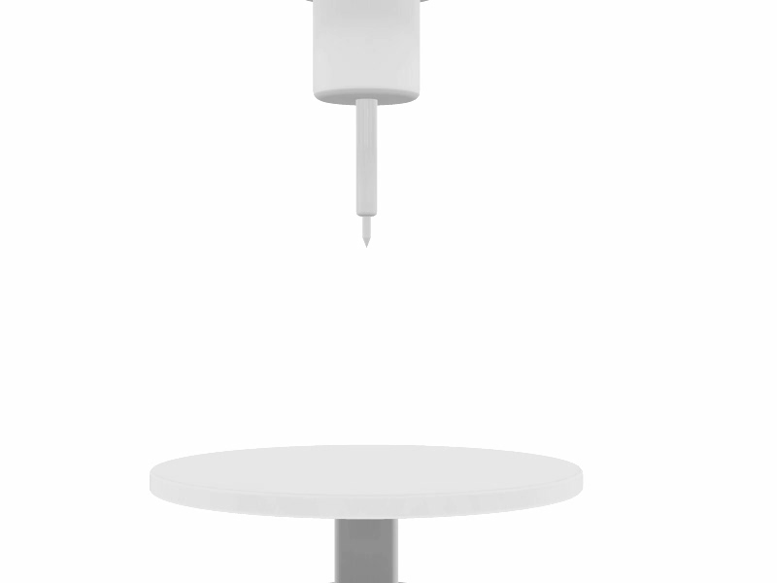
Experimental set-up
103 mm point-plane
67 – 533 mbar
  Artificial air
  N₂
  Ar
  Mixtures

Slide 11
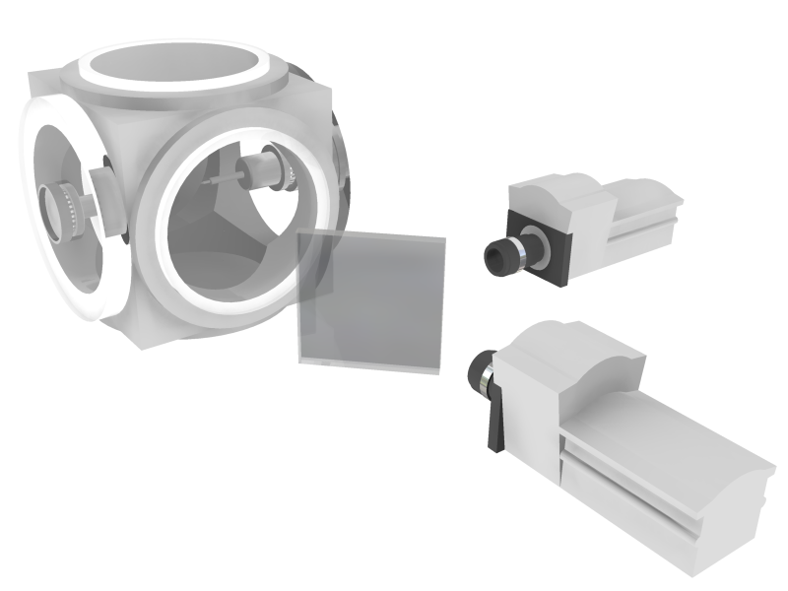
Experimental set-up
103 mm point-plane
67 – 533 mbar
  Artificial air
  N₂
  Ar
  Mixtures
2 ICCD’s

Slide 12
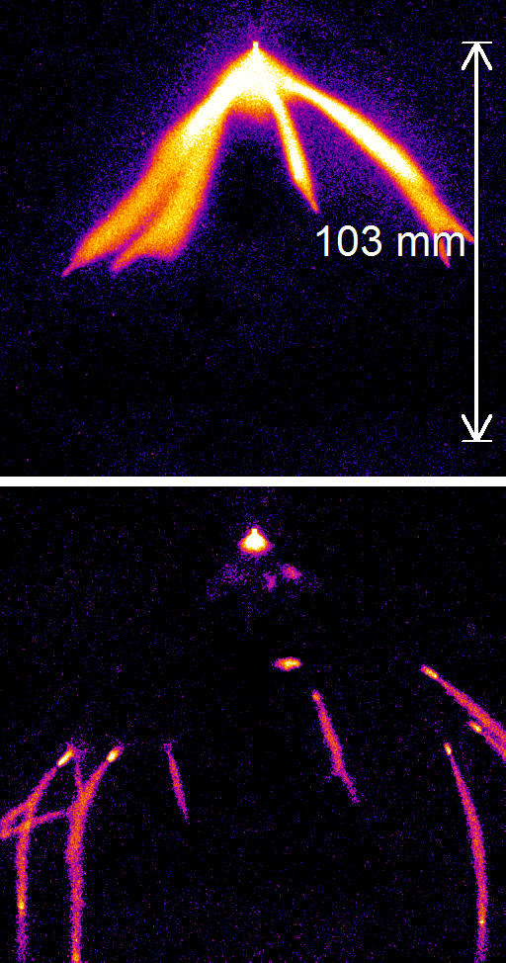
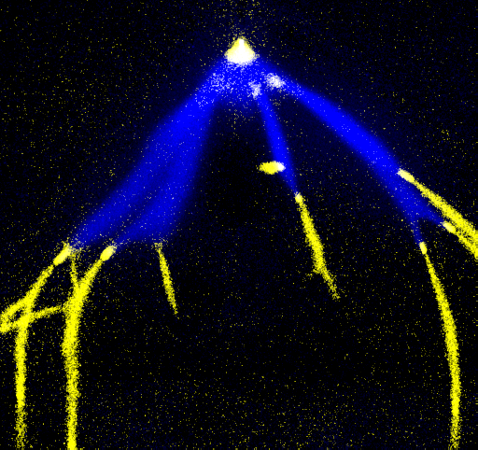
One image per pulse
Camera 2
Camera 1
Camera 1
Camera 2

Slide 13
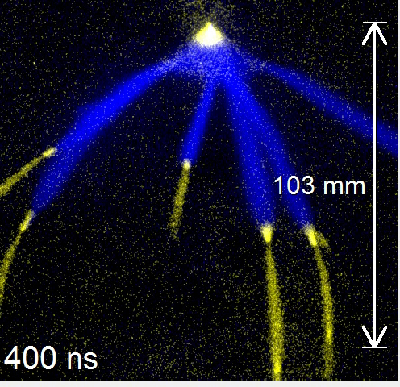
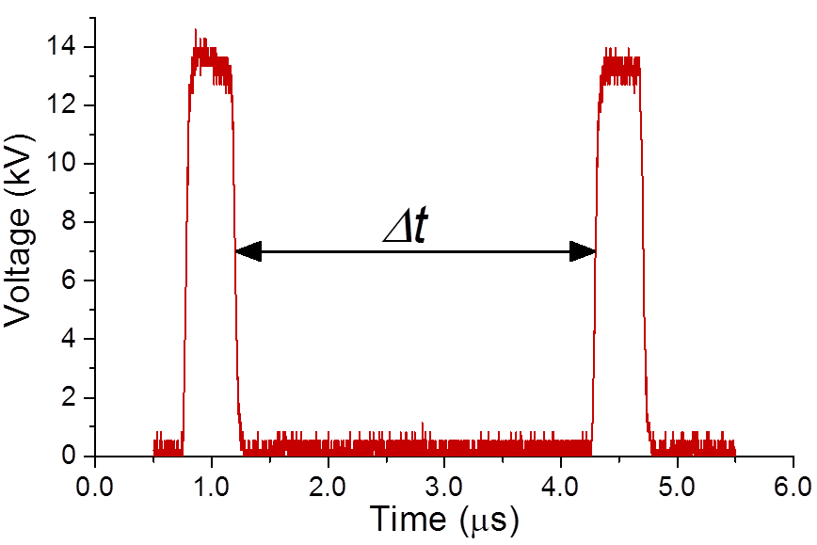
General behaviour
Artificial air
  133 mbar
Pulses
  13.6 kV
  200 ns long

Slide 14
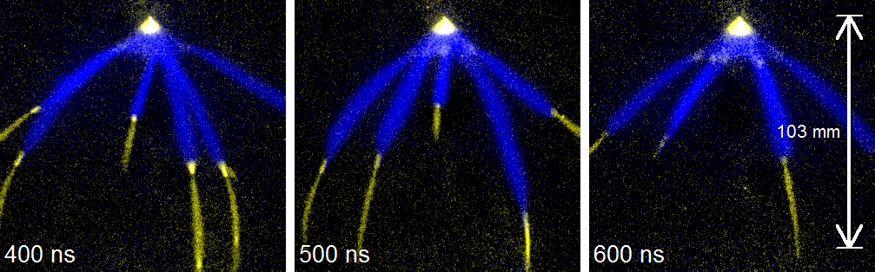

$$Δt<700 ns$$
Previous streamers are continued
Secondary streamers around tip and edge cloud
Second pulse streamers are thinner

Slide 15
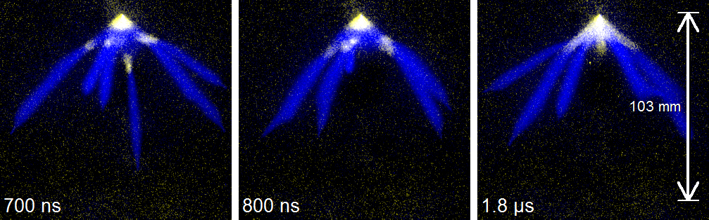

$$700 ns≤Δt<2.5 μs$$
No longer continuation
Secondary streamers more prononounced

Slide 16
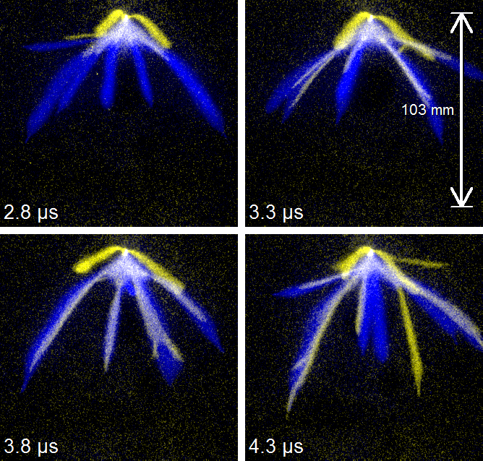

$$2.5 μs≤Δt<5 μs$$
New channels
First avoiding previous discharge
Then following old channels
  Thinner
  On the side

Slide 17
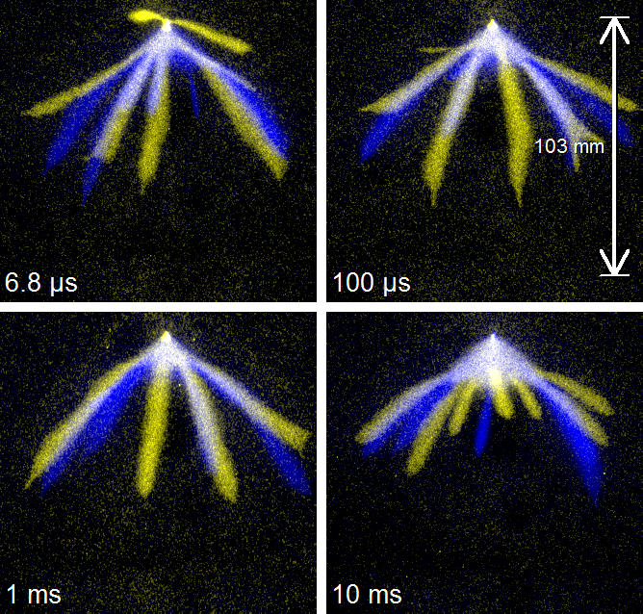

$$Δt>5 μs$$
New channels thicker
More and more independent on previous discharge
At 10 ms completely independent

Slide 18
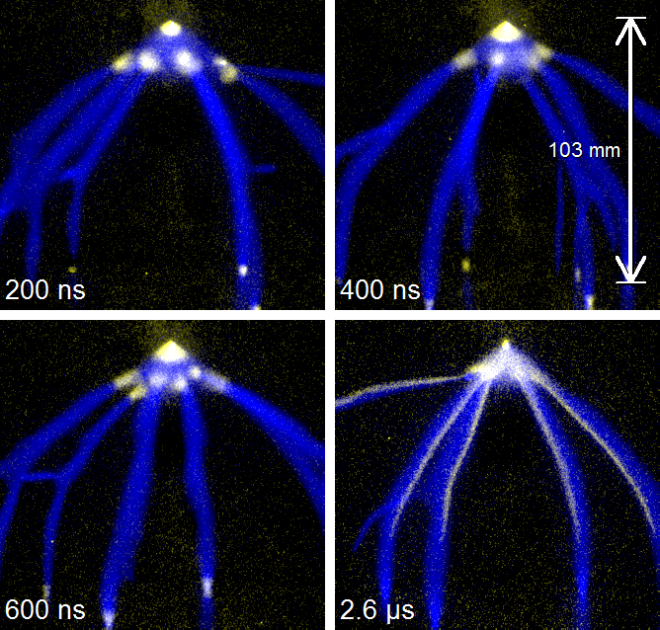
Longer pulses
400 ns pulses instead of 200 ns
No continuation
Cathode spots light up
Otherwise similar

Slide 19
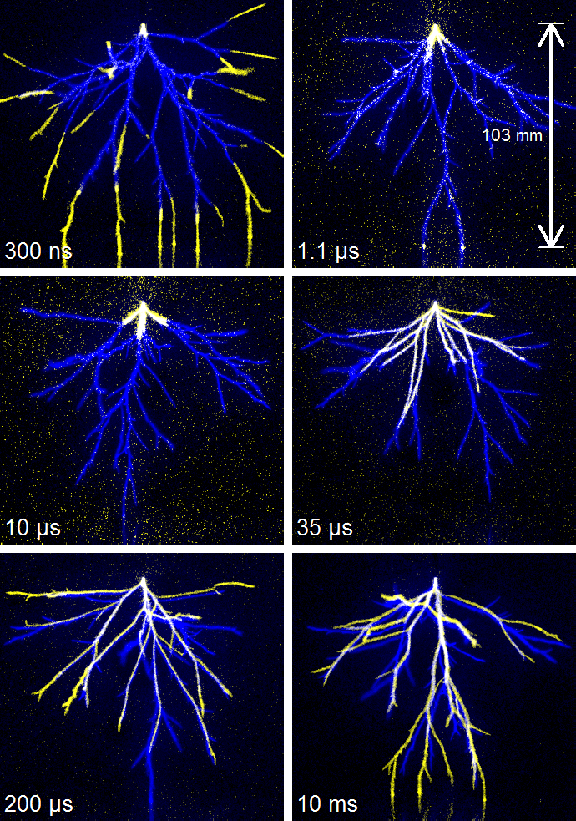
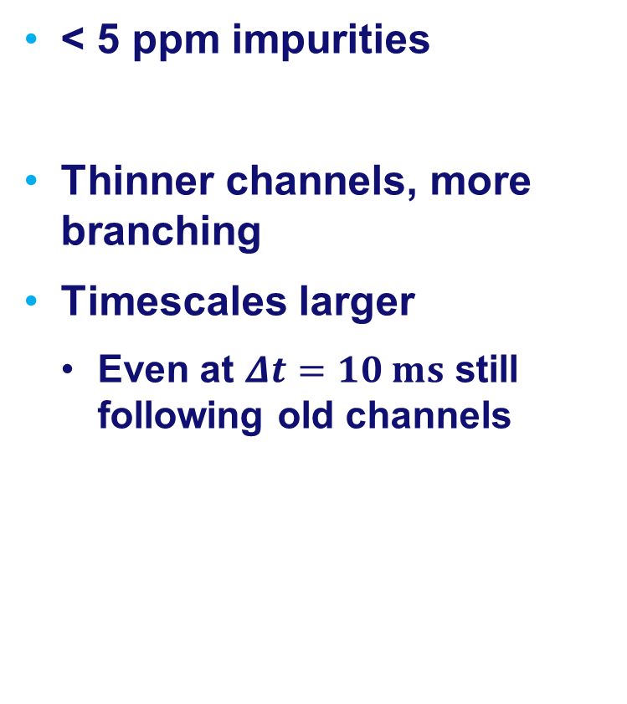
Pure nitrogen
< 5 ppm impurities
Thinner channels, more branching
Timescales larger
  Even at $Δt=10 ms$ still following old channels

Slide 20
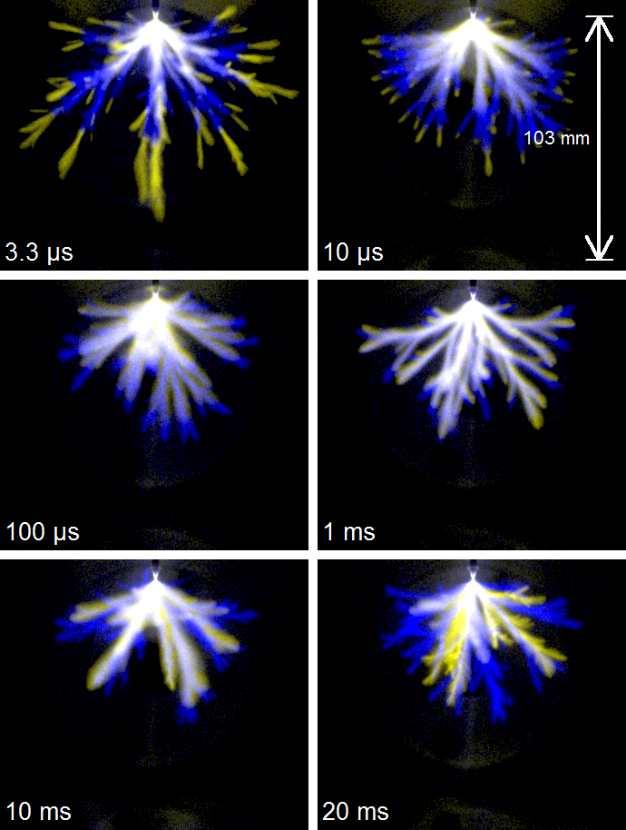
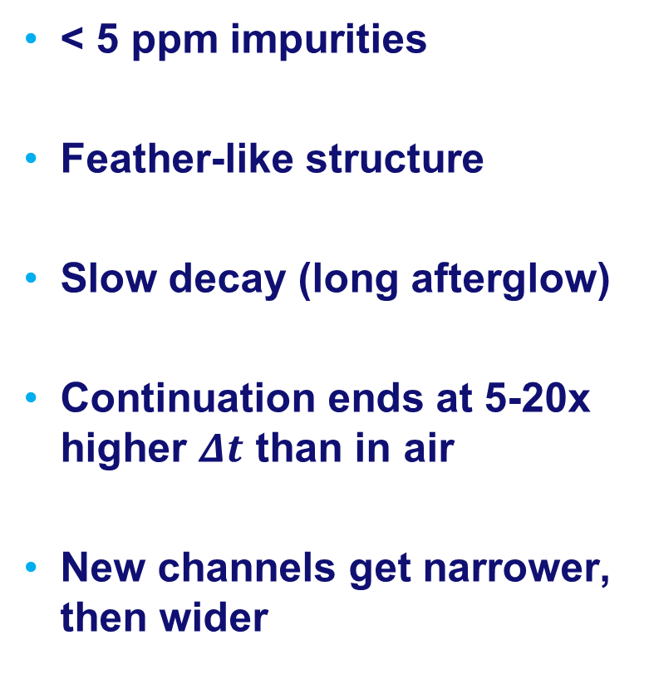
Pure argon
< 5 ppm impurities
Feather-like structure
Slow decay (long afterglow)
Continuation ends at 5-20x higher $Δt$ than in air
New channels get narrower, then wider
Notes:
The large number of channels makes it difficult to tell whether they exactly follow the old paths or, like in nitrogen and air, often follow a path just next to the old path.
Between $Δt=100 μs$ and $Δt=1 ms$ the second-pulse channels get narrower, however, between $Δt=1 ms$ and $Δt=10 ms$ they become wider again. The first effect can probably be attributed to a decrease in background-ionization levels inside the channel, while the second effect may be explained by diffusion of the remaining (low levels) of background ionization.

Slide 21
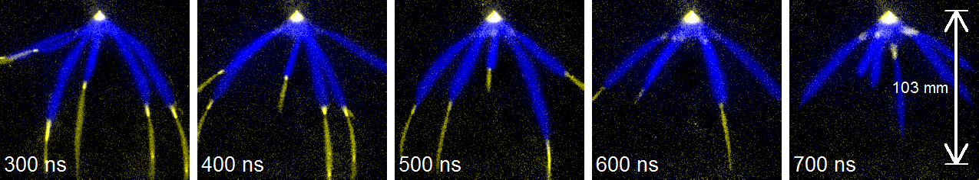
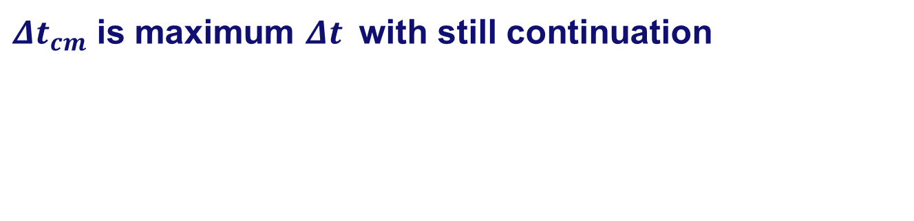

Timing of continuation stop
$$Δt_{cm}$$
$Δt_{cm}$ is maximum $Δt_{ }$ with still continuation

Slide 22
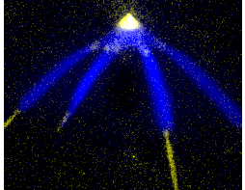

$Δt_{cm}$ as function of pressure
Pulse length: 300 ns

Slide 23
$Δt_{cm}$ as function of pressure
Pulse length: 200 ns

Slide 24

$Δt_{cm}$ as function of oxygen concentration

Slide 25
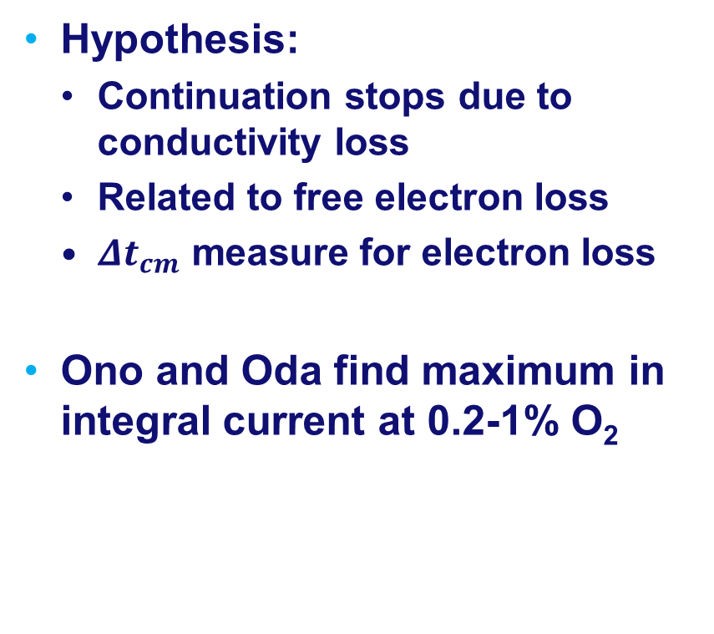
Explanation?
Hypothesis:
  Continuation stops due to conductivity loss
  Related to free electron loss
  $Δt_{cm}$ measure for electron loss
Ono and Oda find maximum in integral current at 0.2-1% O₂
J. Phys. D: Appl. Phys. 36 (2003) 1952

Slide 26

Modelling
0D time-dependent chemistry model
300 ns pulse
Decay
Model contains:
  53 species (N and O)
  650 reactions
End of pulse
$$Δt$$
Arbitrary level

Slide 27
$Δt_{cm}$ as function of oxygen concentration

Slide 28


Major electron loss mechanisms
$$N_{2}^{+}−→N_{4}^{+}−→O_{2}^{+}−→O_{4}^{+}$$
Artificial air
    $$e^{−}+O_{4}^{+}→2O_{2}$$
    $$e^{−}+O_{2}+O_{2}→O_{2}^{−}+O_{2}$$
  Both fast
Pure nitrogen
  $e^{−}+N_{4}^{+}→2N_{2}$
  Fast
Intermediate
  $$e^{−}+O_{2}^{+}→2O_{ }$$
  No fast path!
Integrated electron loss until $n_{e}={5⋅10}^{11} {cm}^{−3}$

Slide 29
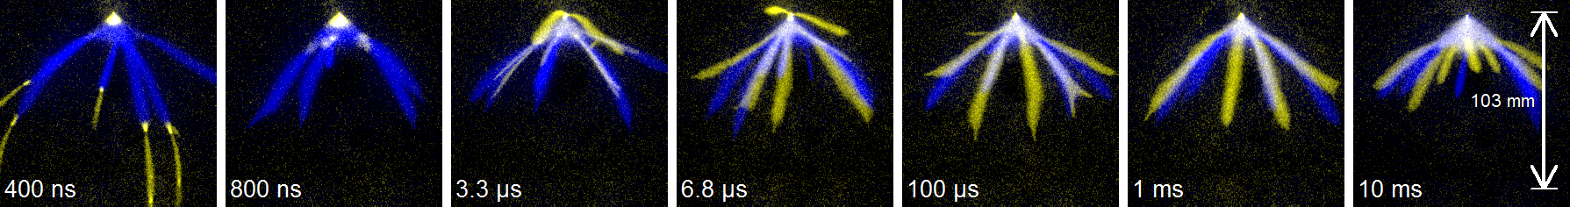
Conclusions and questions
Double pulse method shows
  Streamer decay
  Effects on new streamers
  Long timescale range
Trends similar for all gases
  Details different
  Timings vary

Slide 30
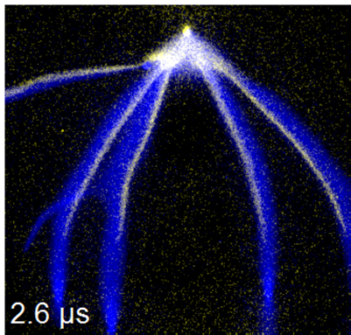
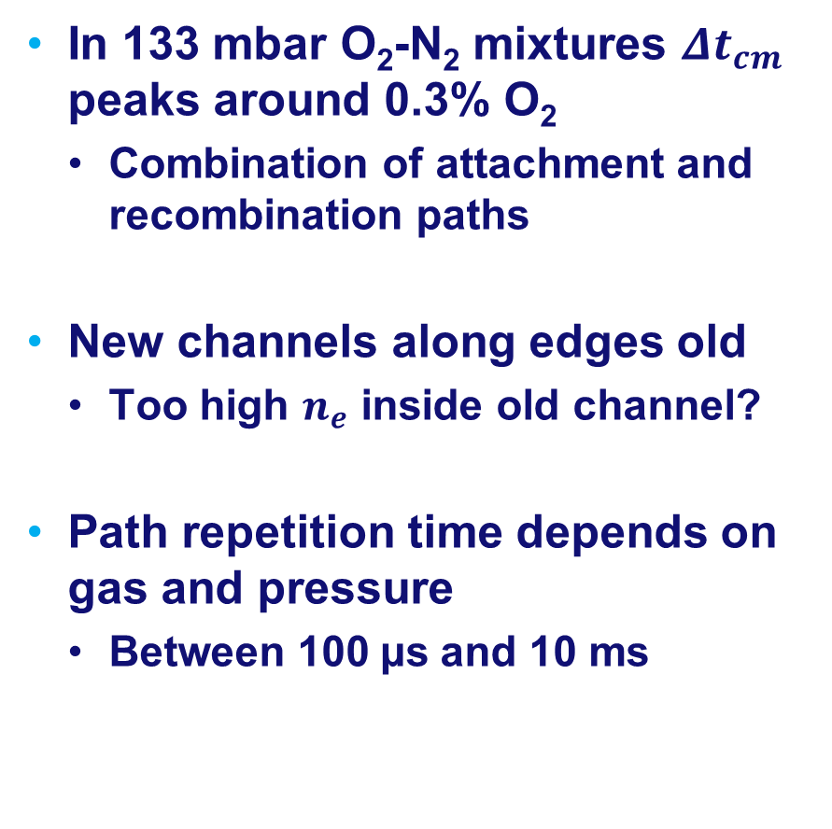
Conclusions and questions
In 133 mbar O₂-N₂ mixtures $Δt_{cm}$ peaks around 0.3% O₂
  Combination of attachment and recombination paths
New channels along edges old
  Too high $n_{e}$ inside old channel?
Path repetition time depends on gas and pressure
  Between 100 µs and 10 ms

Slide 31
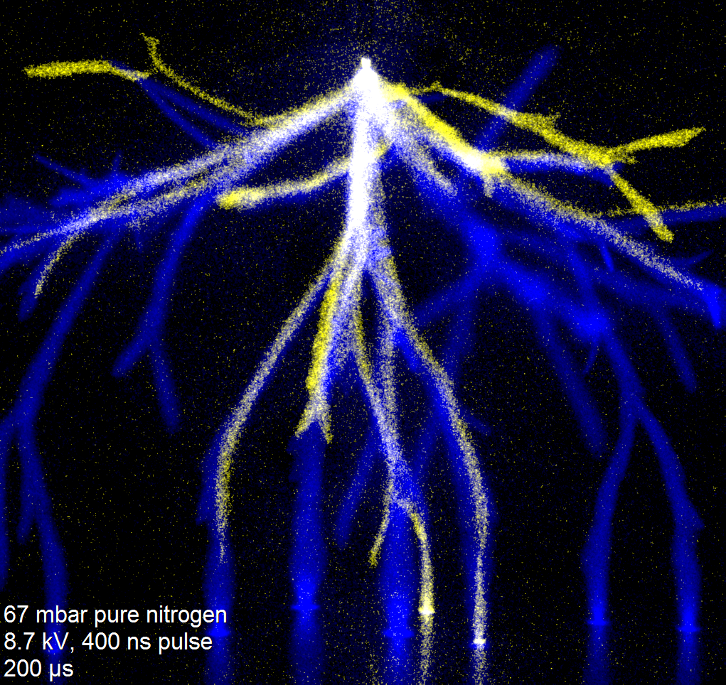

Slide 32
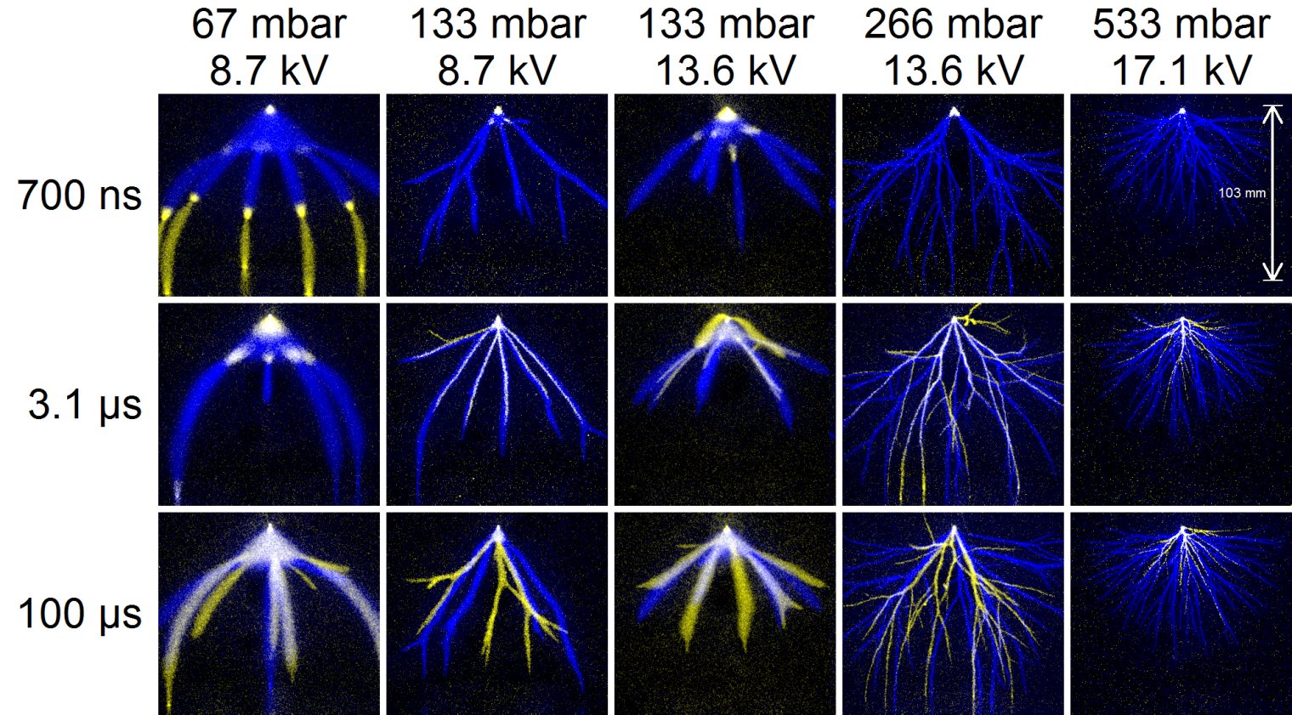
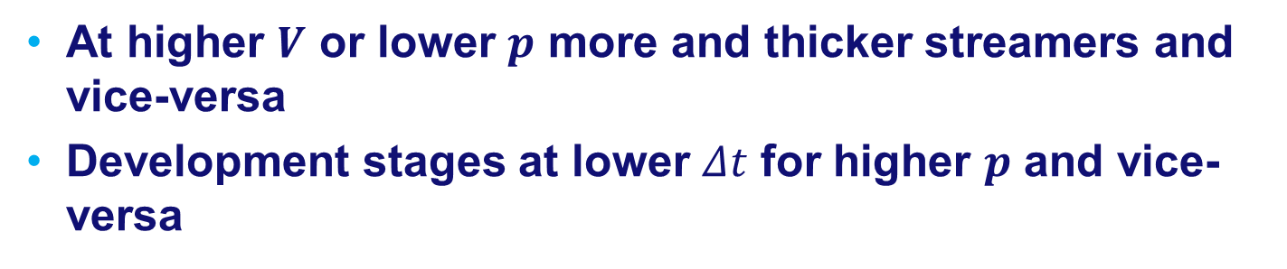
Pressure and voltage
At higher $V$ or lower $p$ more and thicker streamers and vice-versa
Development stages at lower $Δt$ for higher $p$ and vice-versa
Notes:
At higher voltages more and thicker streamers occur while at higher pressures fewer and thinner streamers occur. Furthermore, the different stages of development occur at lower values of $Δt$ for higher pressures and vice-versa.

Slide 33
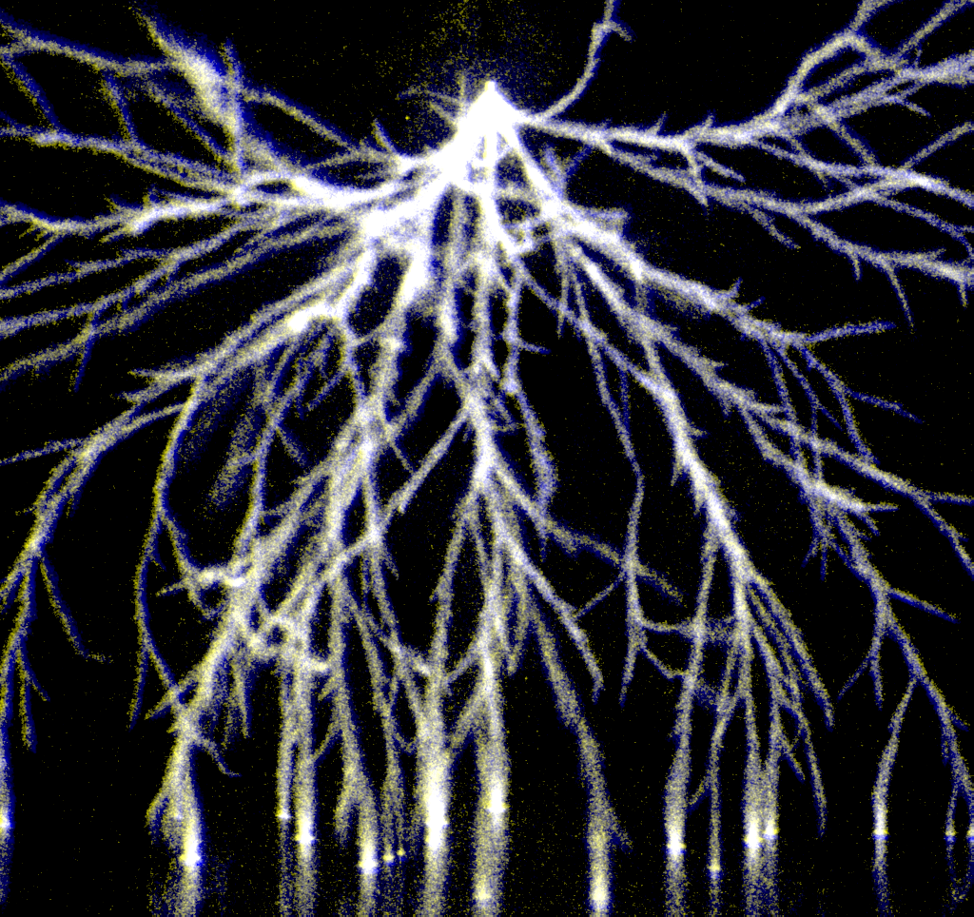
Alignment

