Slide 1
Pulsed power and transient plasma research
@ TU/e-EES

Slide 2
Drift step recovery diodes for HV pulsing

Slide 3
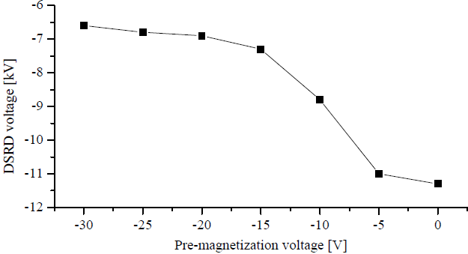
Drift step recovery diodes for HV pulsing

Slide 4
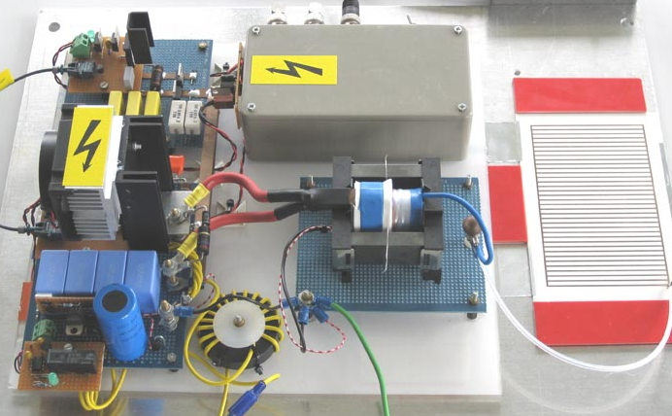
Pulsed SDBD

Slide 5
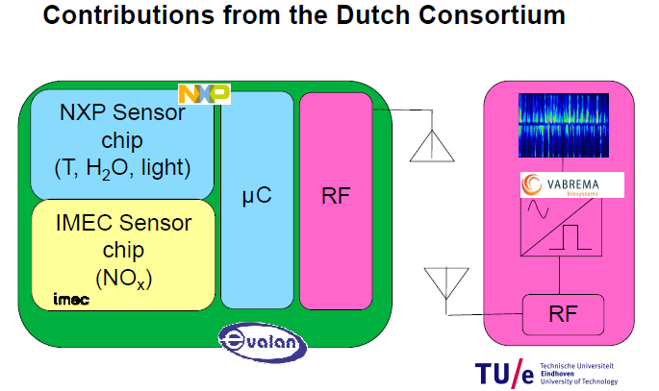
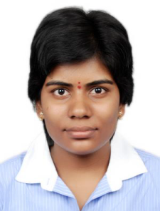

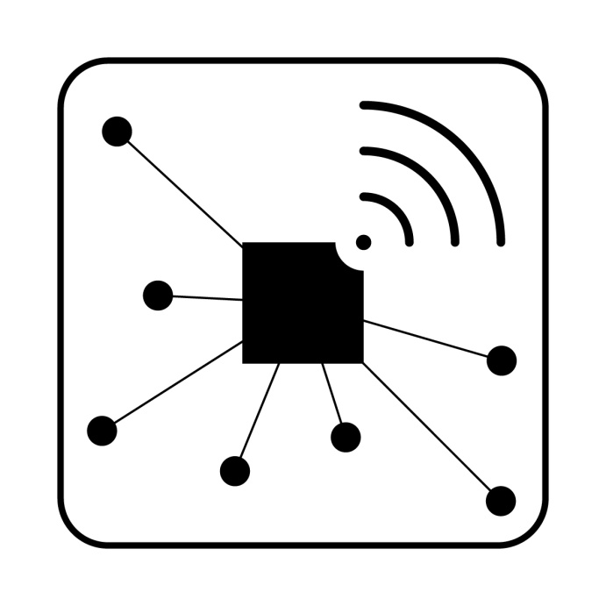
On-demand air purification

Slide 6
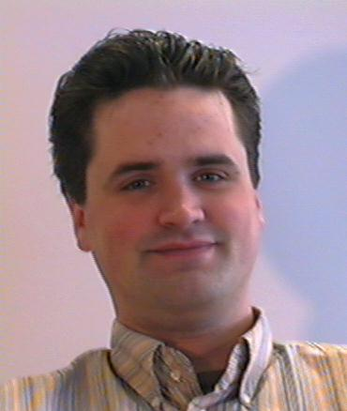
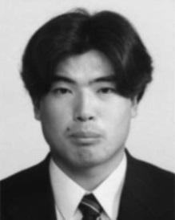
Pulsed corona...a very efficient source of radicals…
...but requires very short and powerful HV pulses.

Slide 7
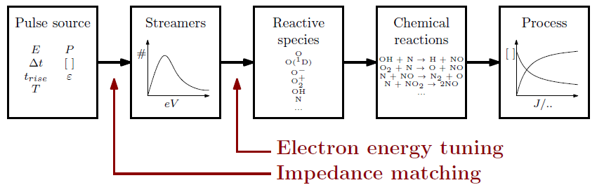
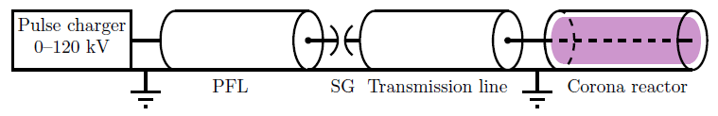
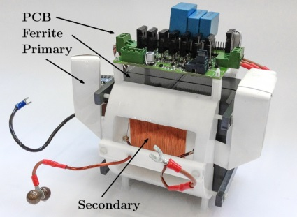
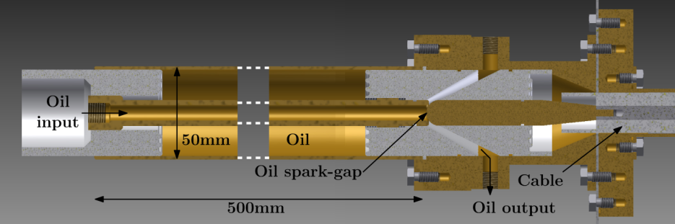
60 kV, 1-5 ns, 200 ps rise time, repetitive

Slide 8
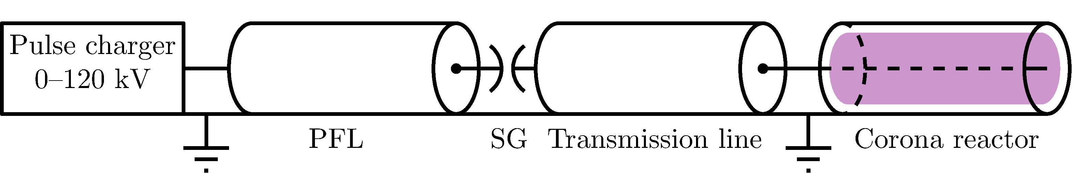

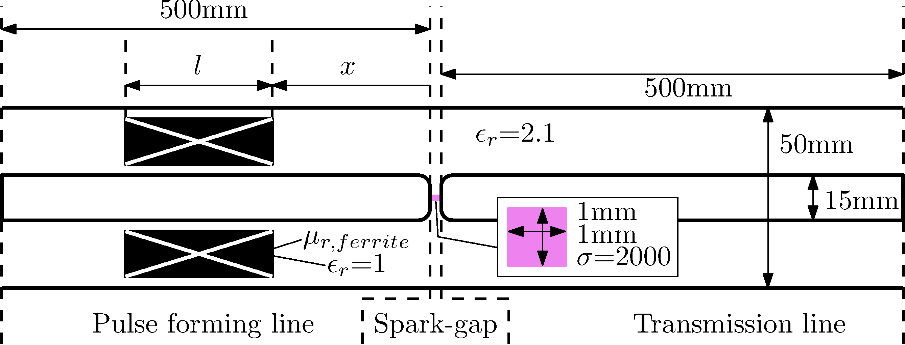

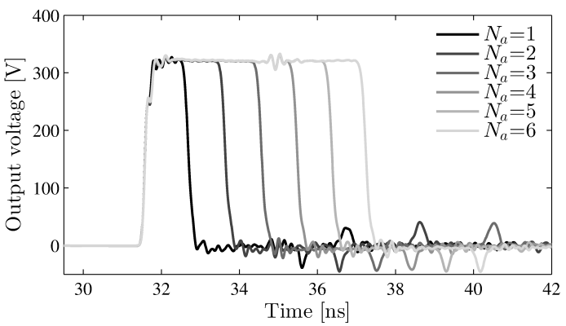
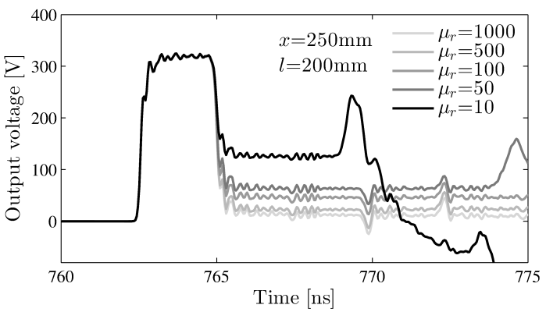
ns streamer plasma generation
How to adjust pulse duration?

Slide 9
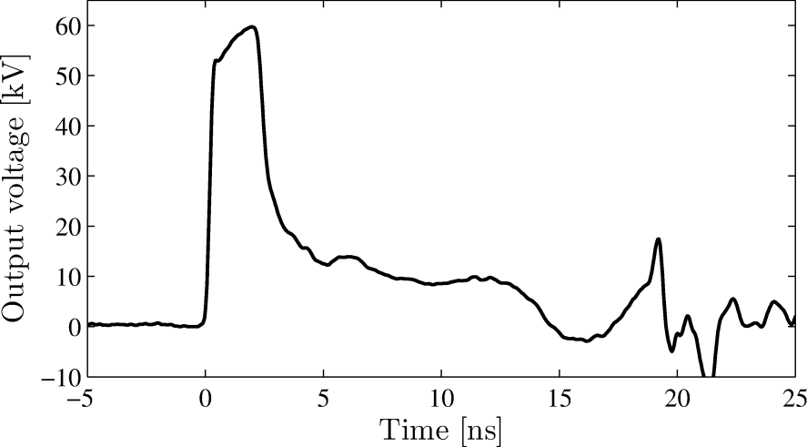
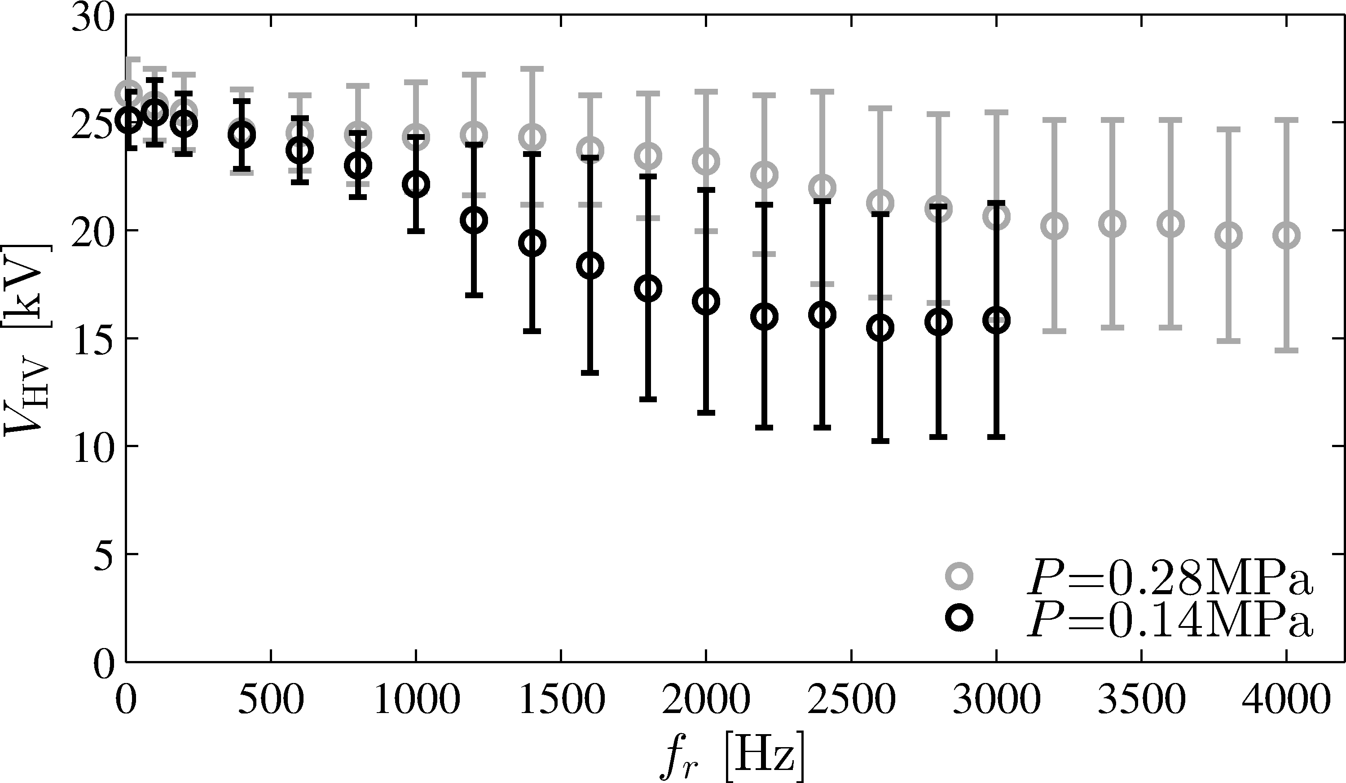
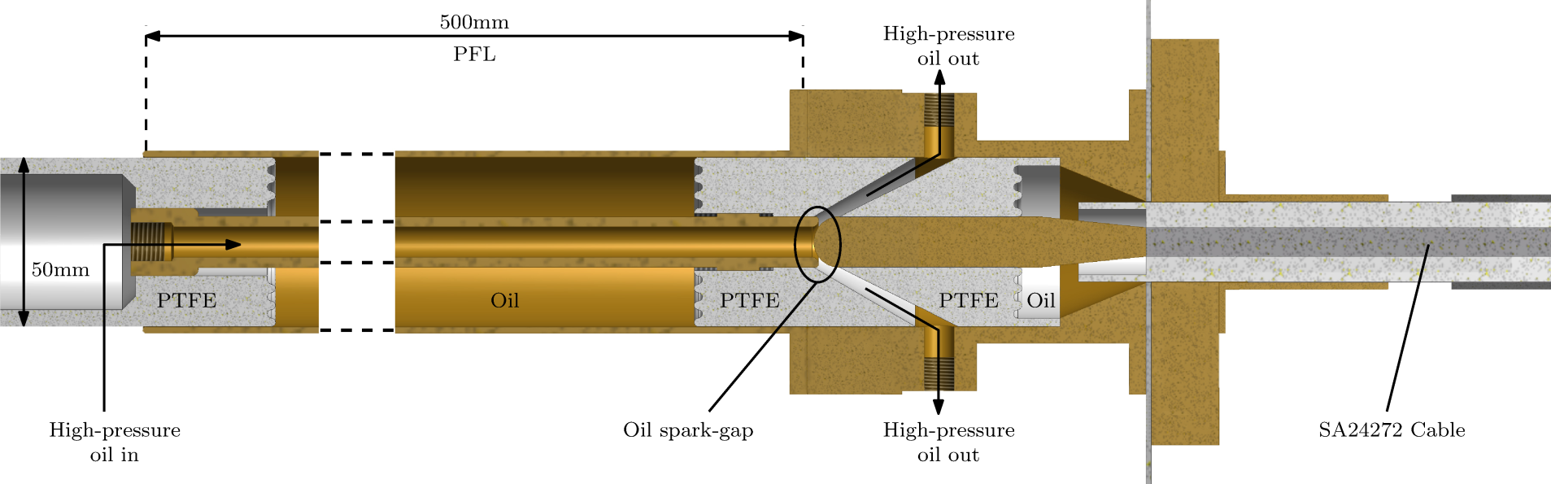
ns streamer plasma generation
First implementation

Slide 10
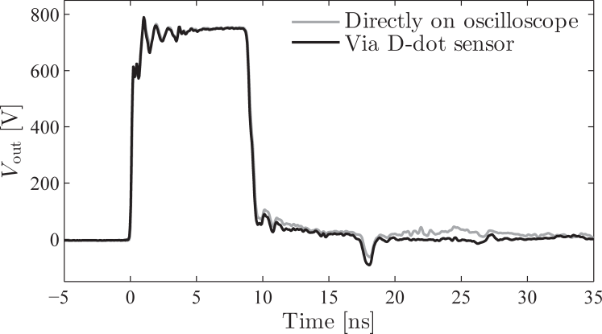
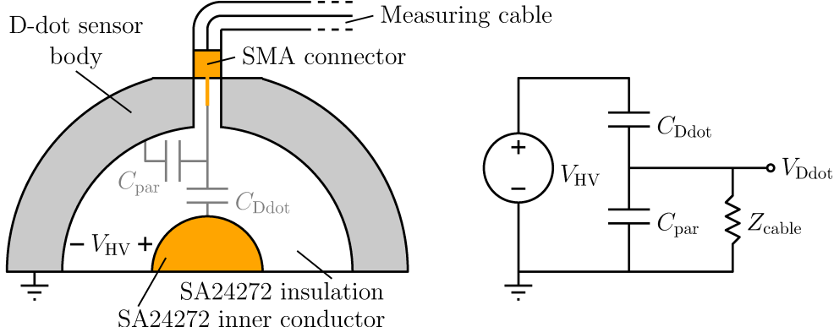
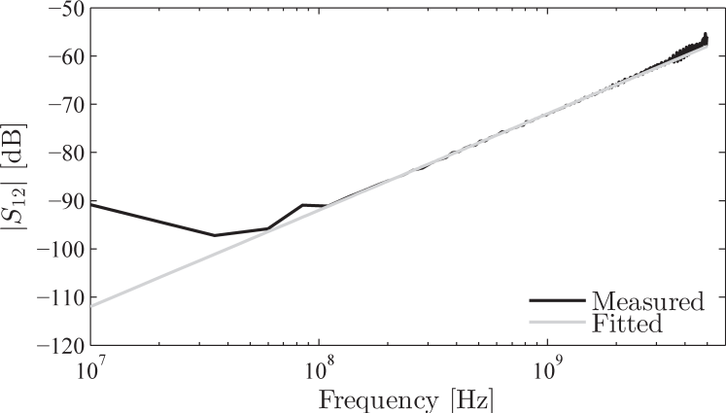
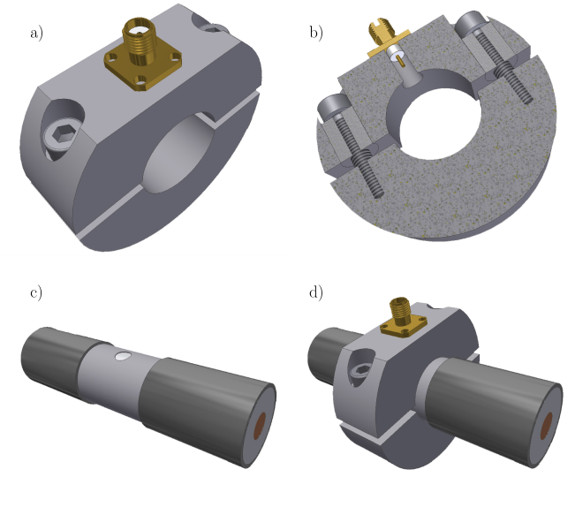
ns streamer plasma generation
Voltage diagnostic

Slide 11
Pulsed power to plasma matching
Electrical impedance of a streamer

Slide 12
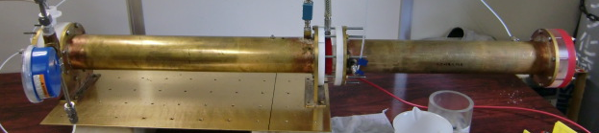
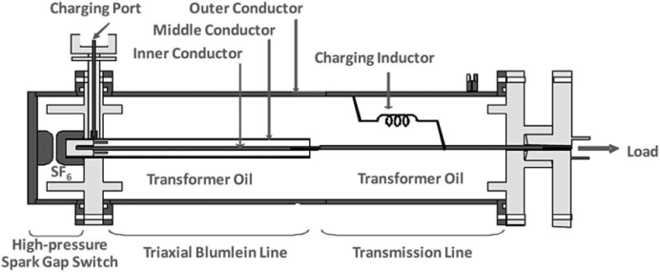
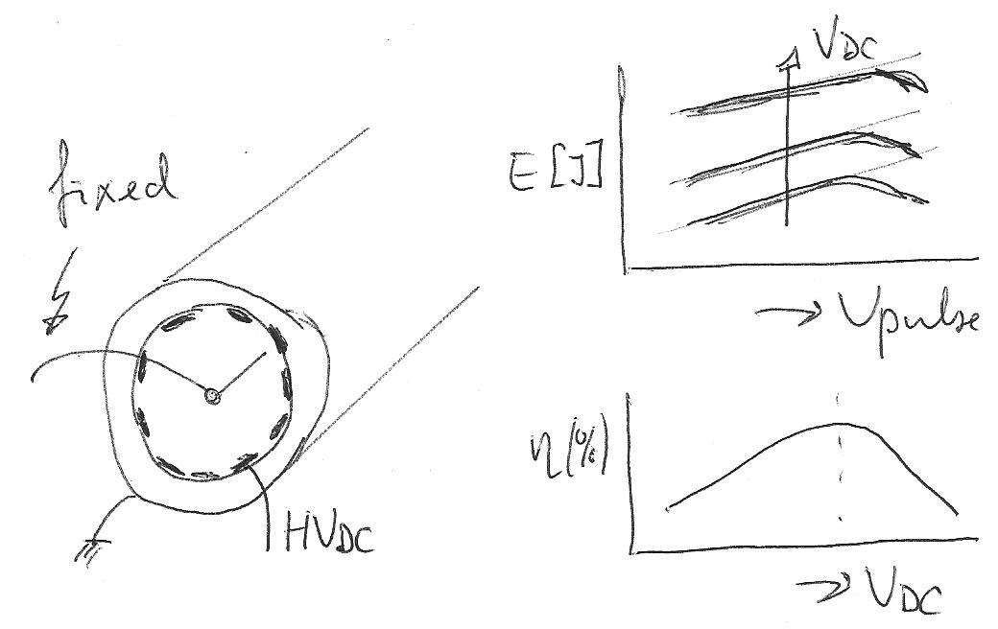
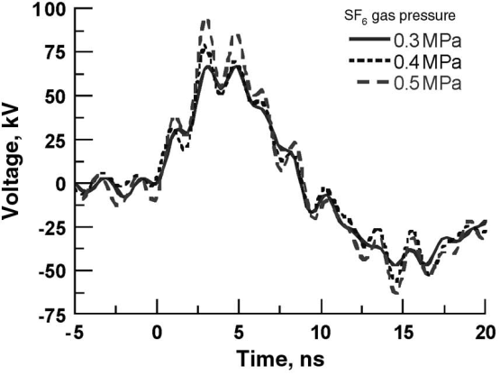
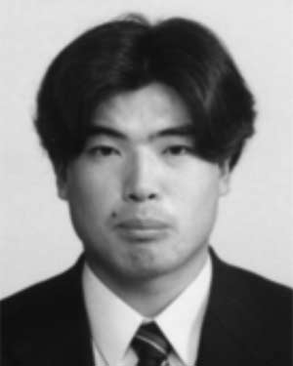
ns streamer plasma generation
First matching experiment @ Kumamoto Univ

Slide 13
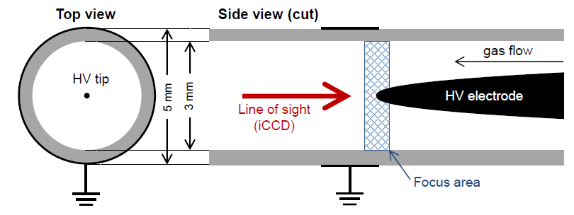
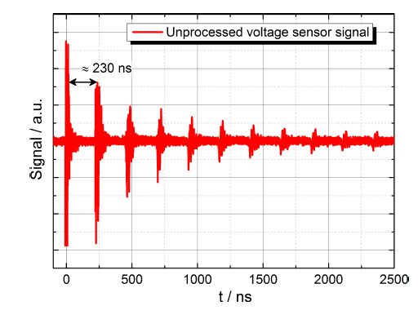
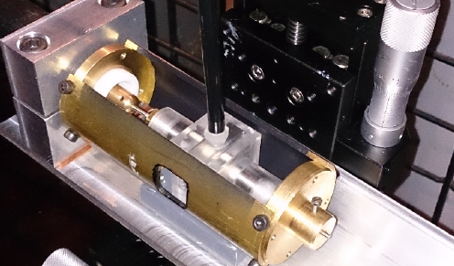
ns streamer plasma generation
First plasma – by Hans Hoft, INP Greifswald

Slide 14
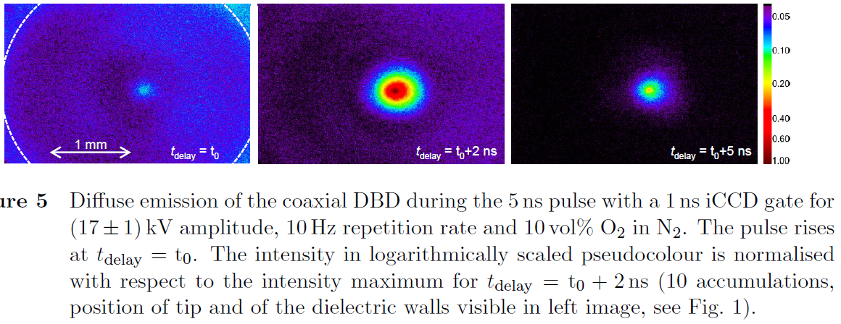
ns streamer plasma generation
First plasma – by Hans Hoft, INP Greifswald

Slide 15
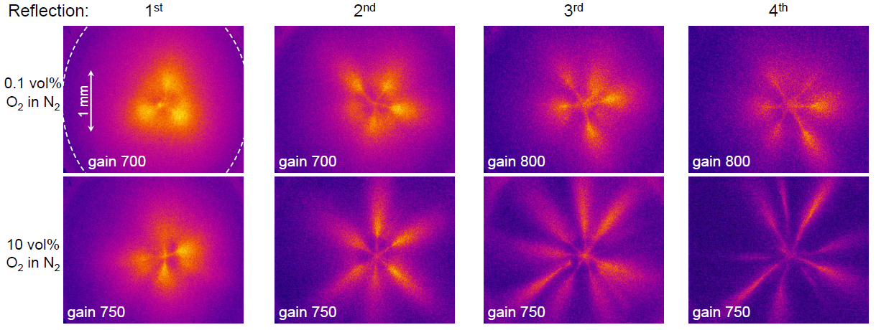
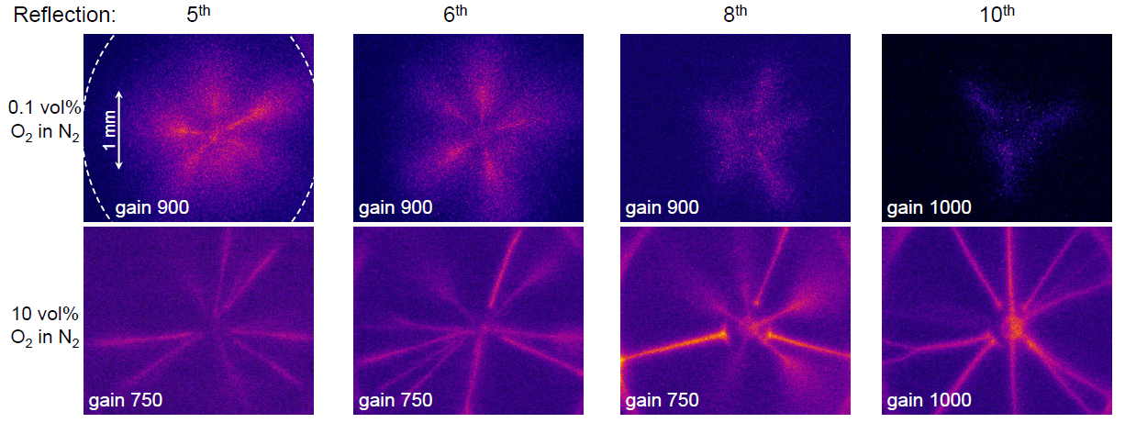
ns streamer plasma generation
First plasma – by Hans Hoft, INP Greifswald

Slide 16


Slide 17
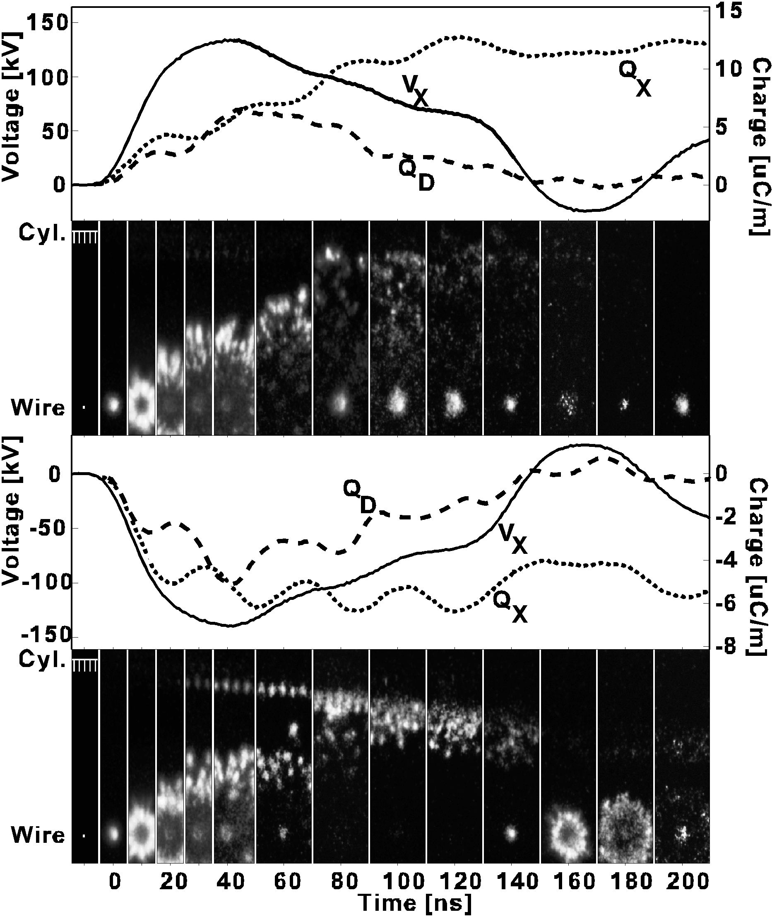
Pulsed corona discharges
Primary streamers
Secondary or late streamers (can be avoided by using short pulses)
fast ICCD
end-on
views
IEEE Trans. On Plasma Science, Vol.26, No.5, Oct.1998, pp.1476-1484

